Slide 1
Playing the short game
The effects of data breaches on share prices
By Chaim Sanders

Slide 2






Chaim Sanders
DISCLAIMER: This presentation should not be taken as financial advice.

Slide 3



Agenda
Data Analysis
Motivation
Results

Slide 4
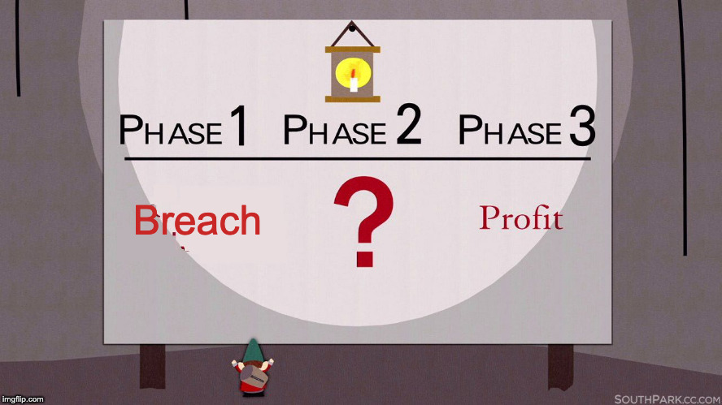
Motivation
We’ve all heard … After a breach, share prices drop
Is this True?
Does it Matter?

Slide 5
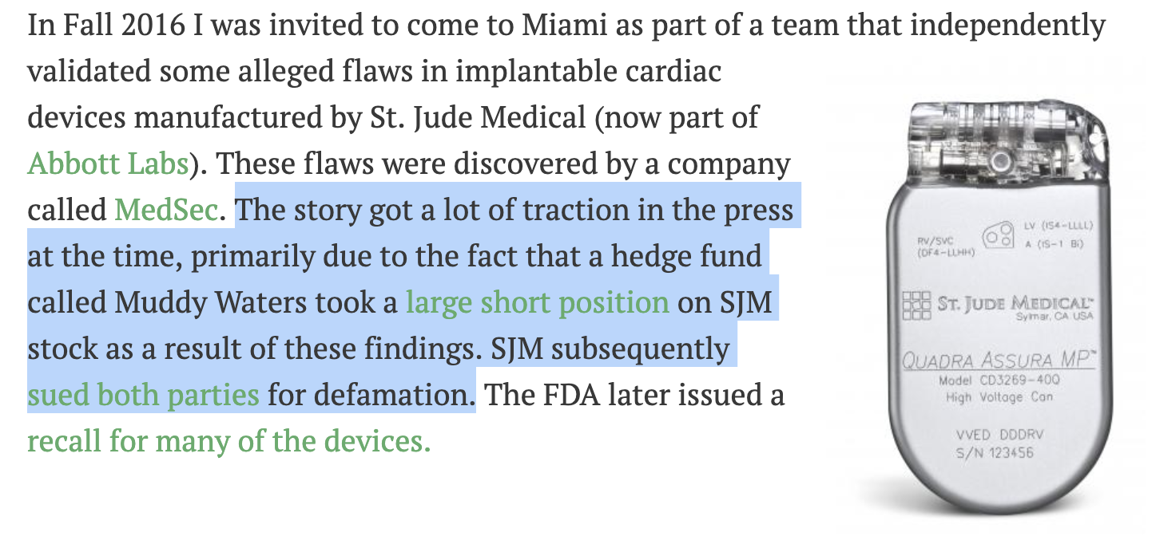
https://motherboard.vice.com/en_us/article/bj5wy4/amd-flaws-viceroy-short-selling-stock-market

Slide 6
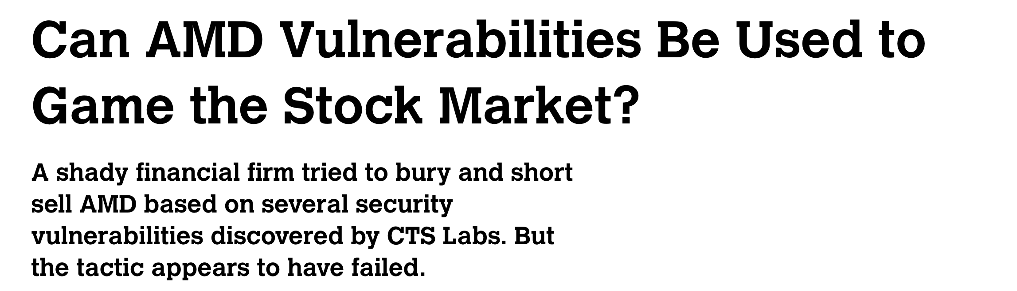
https://motherboard.vice.com/en_us/article/bj5wy4/amd-flaws-viceroy-short-selling-stock-market

Slide 7

SCIENCE

Slide 8
Previous Work
comparitech.com^{[1]} provided the most detailed results
24 Companies (28 breaches)
Focused on largest breaches (and large companies)
Occurred from 2007-2018
All NASDAQ Stocks
Share prices of breached companies hit a low point approximately 14 market days following a breach. Share prices fall 2.89% on average, and underperform the NASDAQ by -4.6%
[1] https://www.comparitech.com/blog/information-security/data-breach-share-price-2018/

Slide 9
Methodology
First iteration: 261 data breaches as listed on Wikipedia
This iteration: Expanded to include the VERIS Community Database (3369 breaches) and PrivacyRights.org (9362 breaches)
We limited our observation to publicly traded companies and enriched the data
Added exchange, symbol
Size of company
What data was breached
Amount of records breached
Breach type

Slide 10
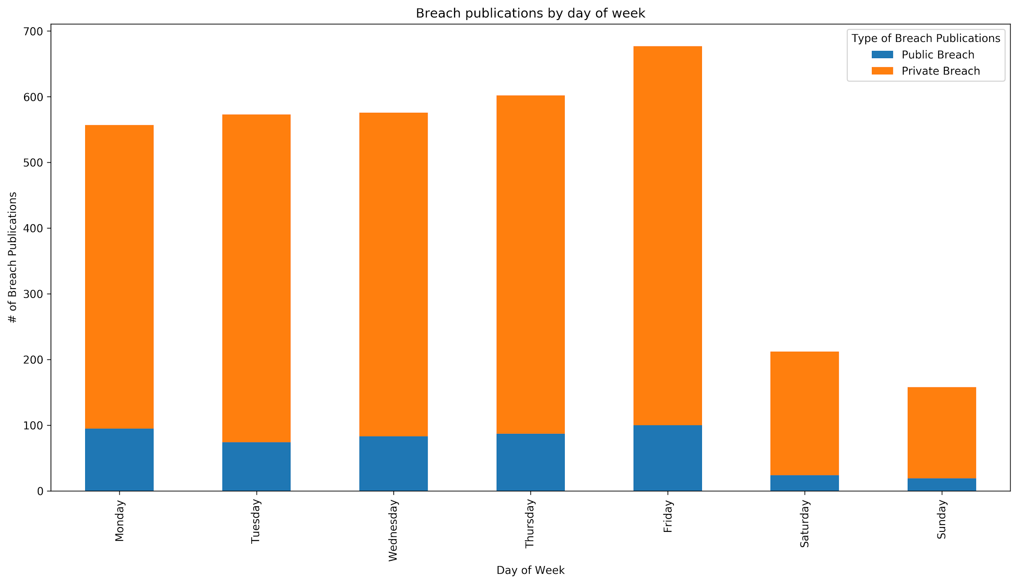
Friday is the most common day. Trying to bury it over the weekend cycle

Slide 11
What is an “in scope breach”
Acceptable:
1000 credit cards leaked
1 billion passwords leaked
183 employees had PHI leaked
Not Acceptable
Denial of Service
Defacement
Skimmer
Not enough Information
SSN may be visible through envelope window
Bank Clerk Steals identity
23 individuals had their identity stolen

Slide 12
Pruning the Data
We started with 482 publicly traded companies (that could be validated)
Here publicly means that shares were offered to the public at the time the breach notification occured
We reduced by only looking at NYSE/NASDAQ (removed 125 breaches)
We reduced based if it was an “in scope breach” (removed 205)
We were able to obtain stock data for 152 “in-scope” breaches
542% increase in total analyzed breaches
127 Companies (152 breaches) - ~16.5% repeat breaches

Slide 13
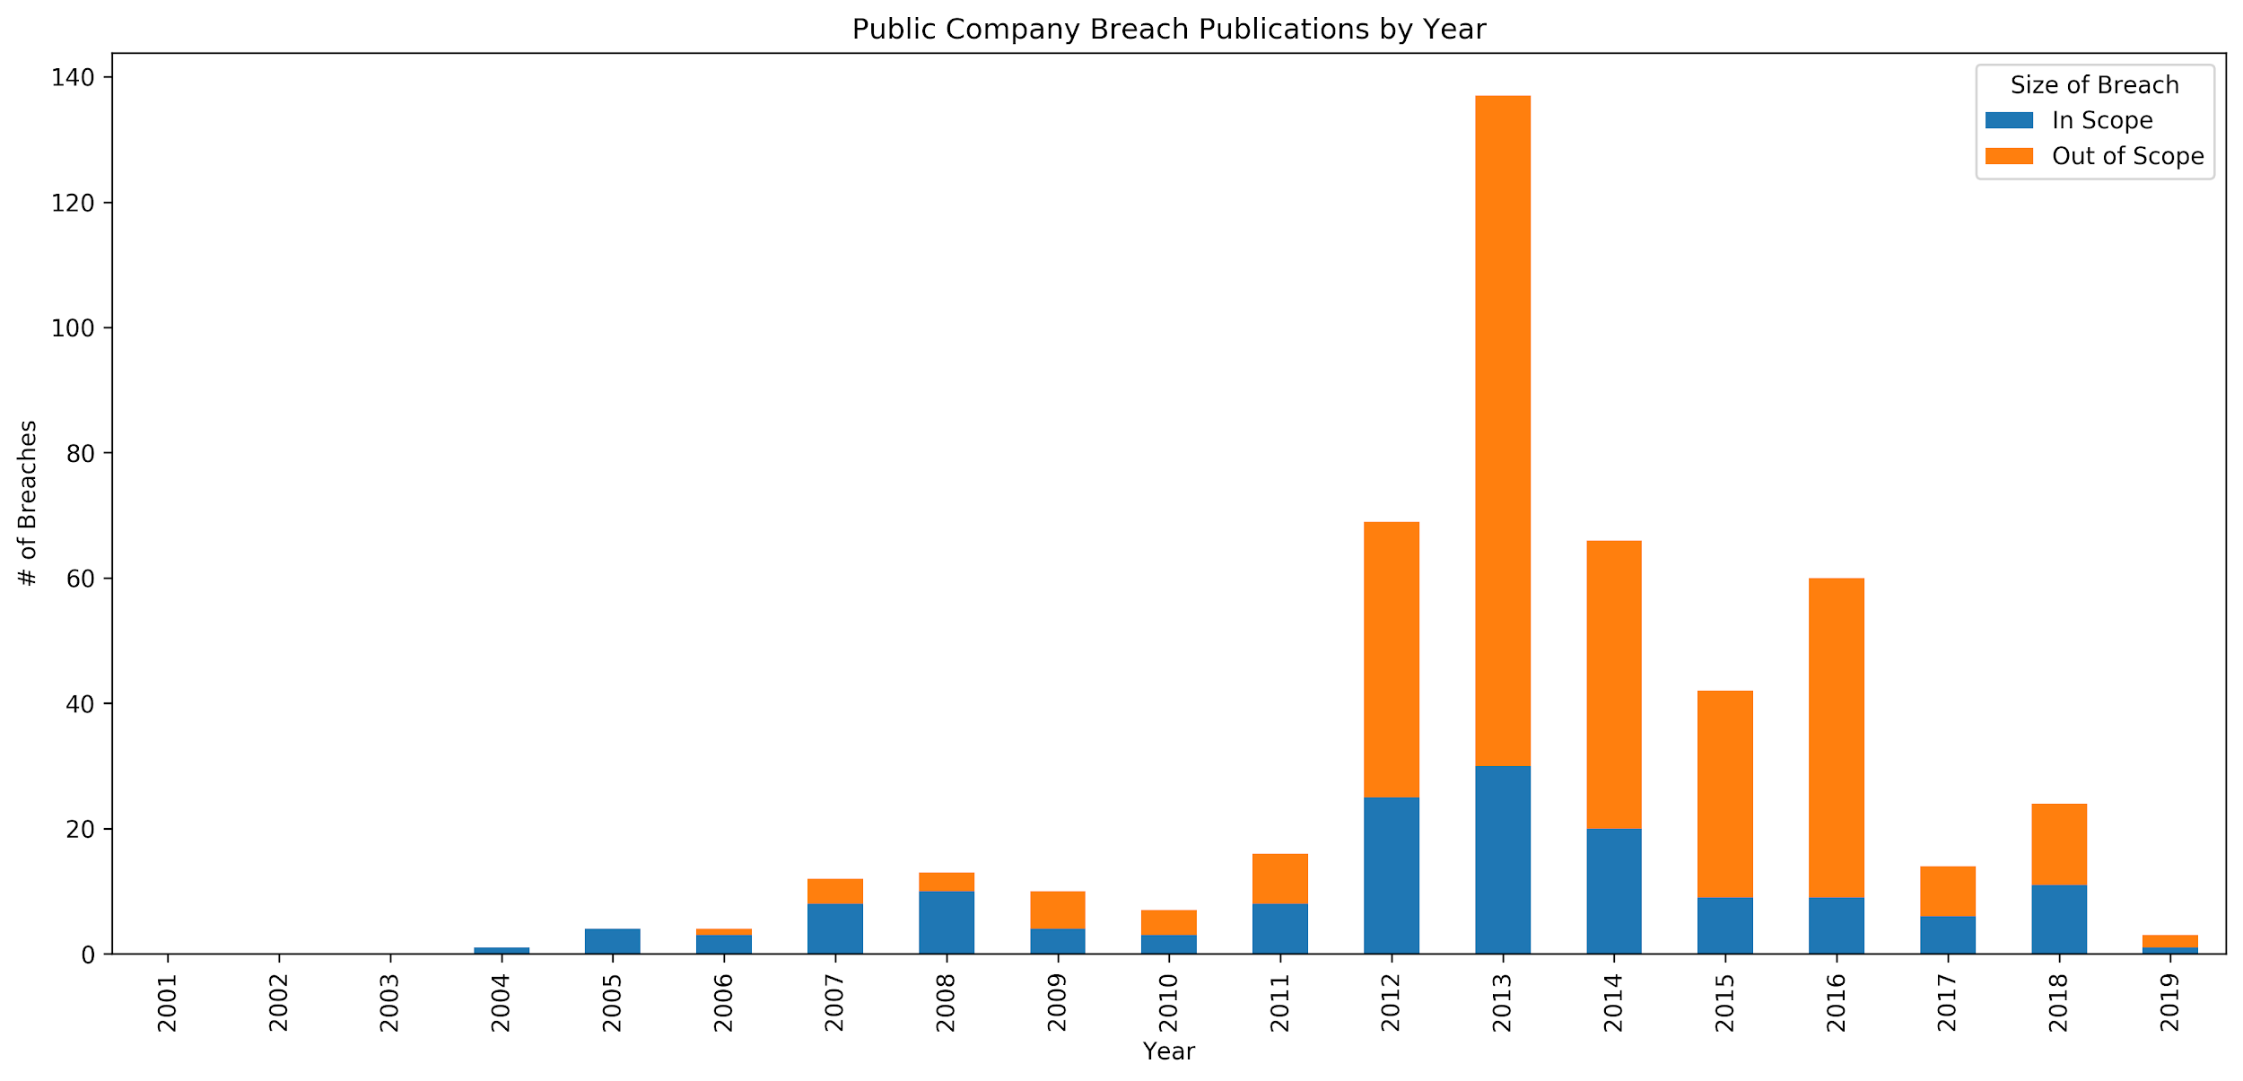
This shape reflects the VCDB data for all stocks
In-scope start reflecting general trends
2001 | 2002 | 2003 | 2004 | 2005 | 2006 | 2007 | 2008 | 2009 | 2010 | 2011 | 2012 | 2013 | 2014 | 2015 | 2016 | 2017 | 2018 | 2019
0 | 0 | 0 | 1 | 4 | 3 | 8 | 10 | 4 | 3 | 8 | 25 | 30 | 20 | 9 | 9 | 6 | 11 | 1

Slide 14
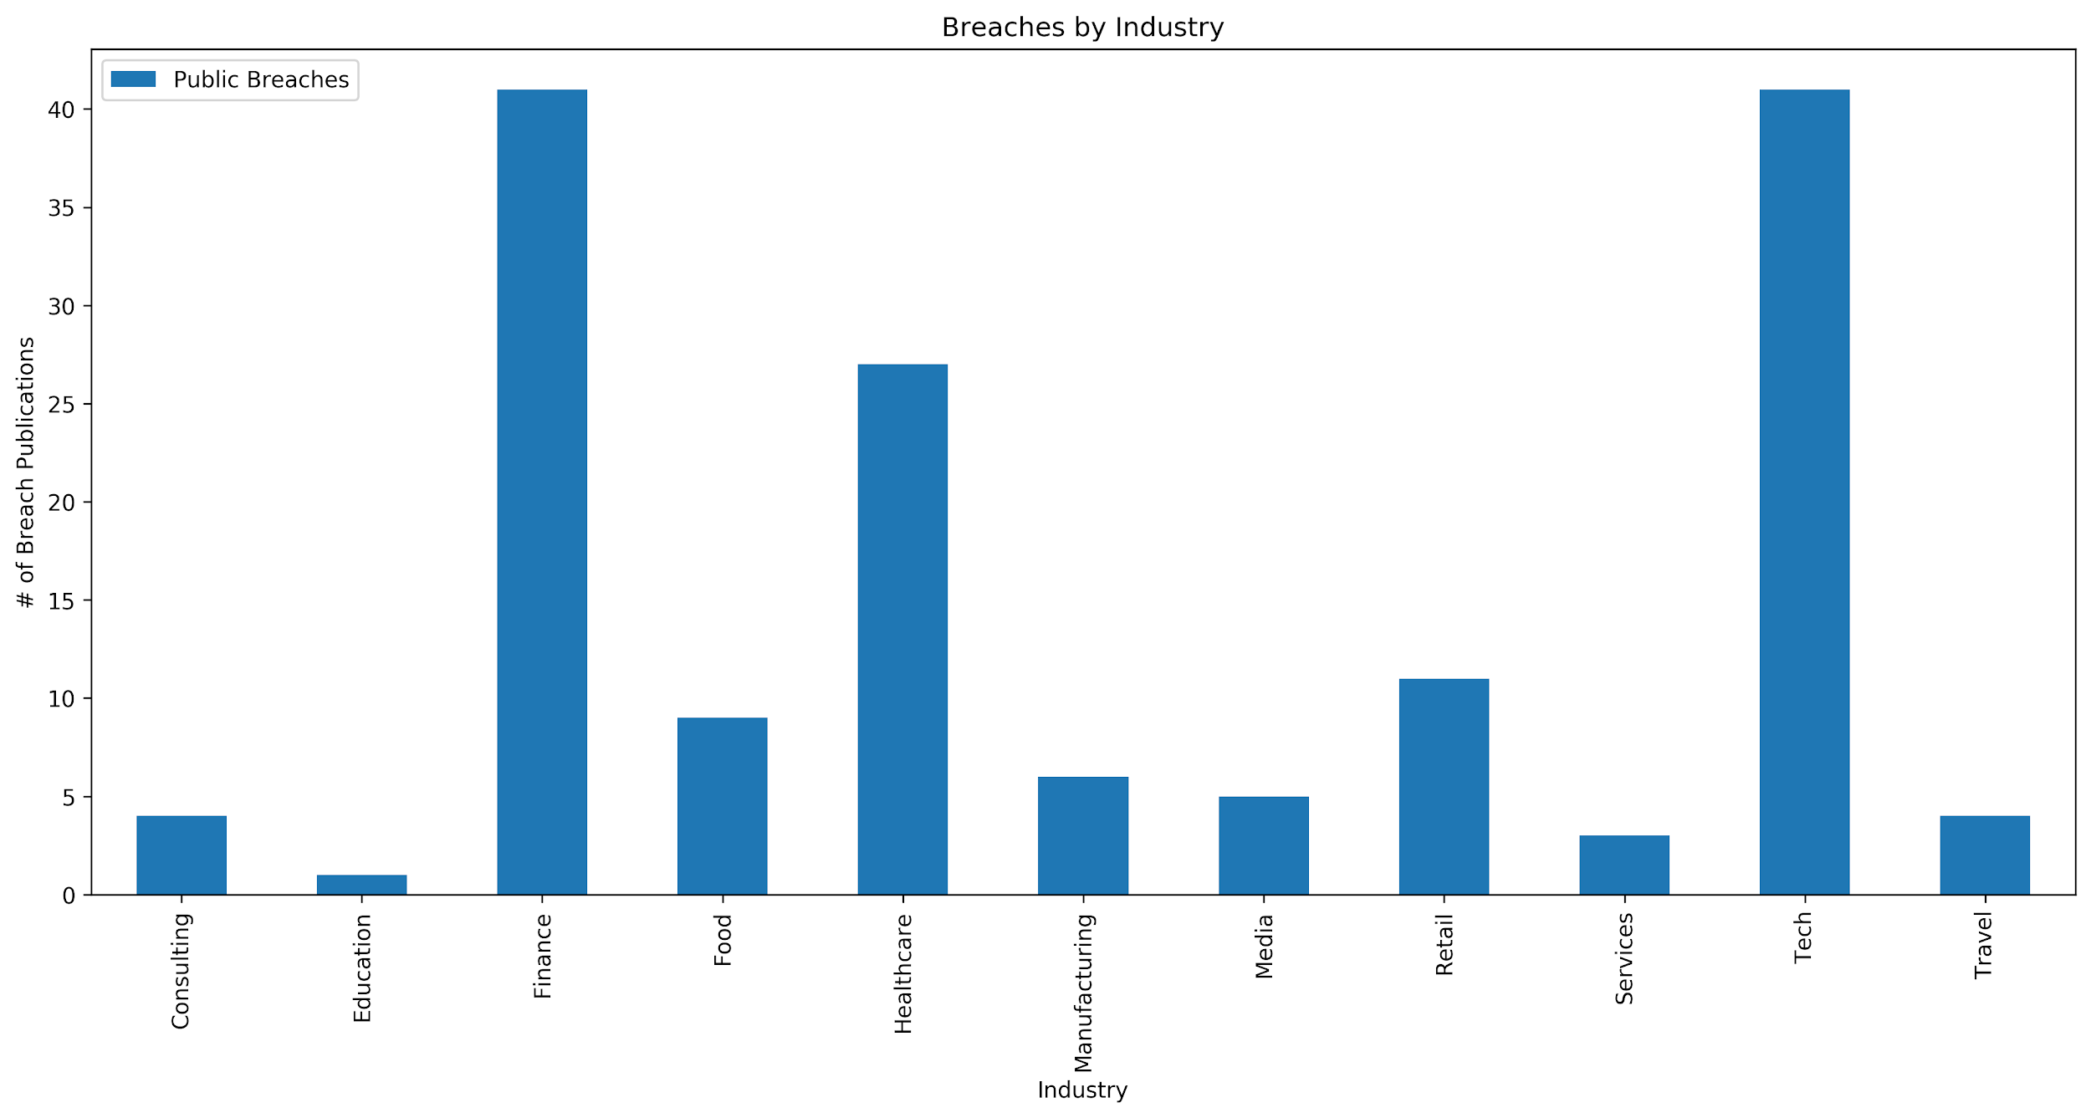
Tech and Finance make up disproportionate amount
Most Educational institutions are not public
Many Hospitals are not public. This is a large amount
Consulting | Education | Finance | Food | Healthcare | Manufacturing | Media | Retail | Services | Tech | Travel
4 | 1 | 41 | 9 | 27 | 6 | 5 | 11 | 3 | 41 | 4

Slide 15
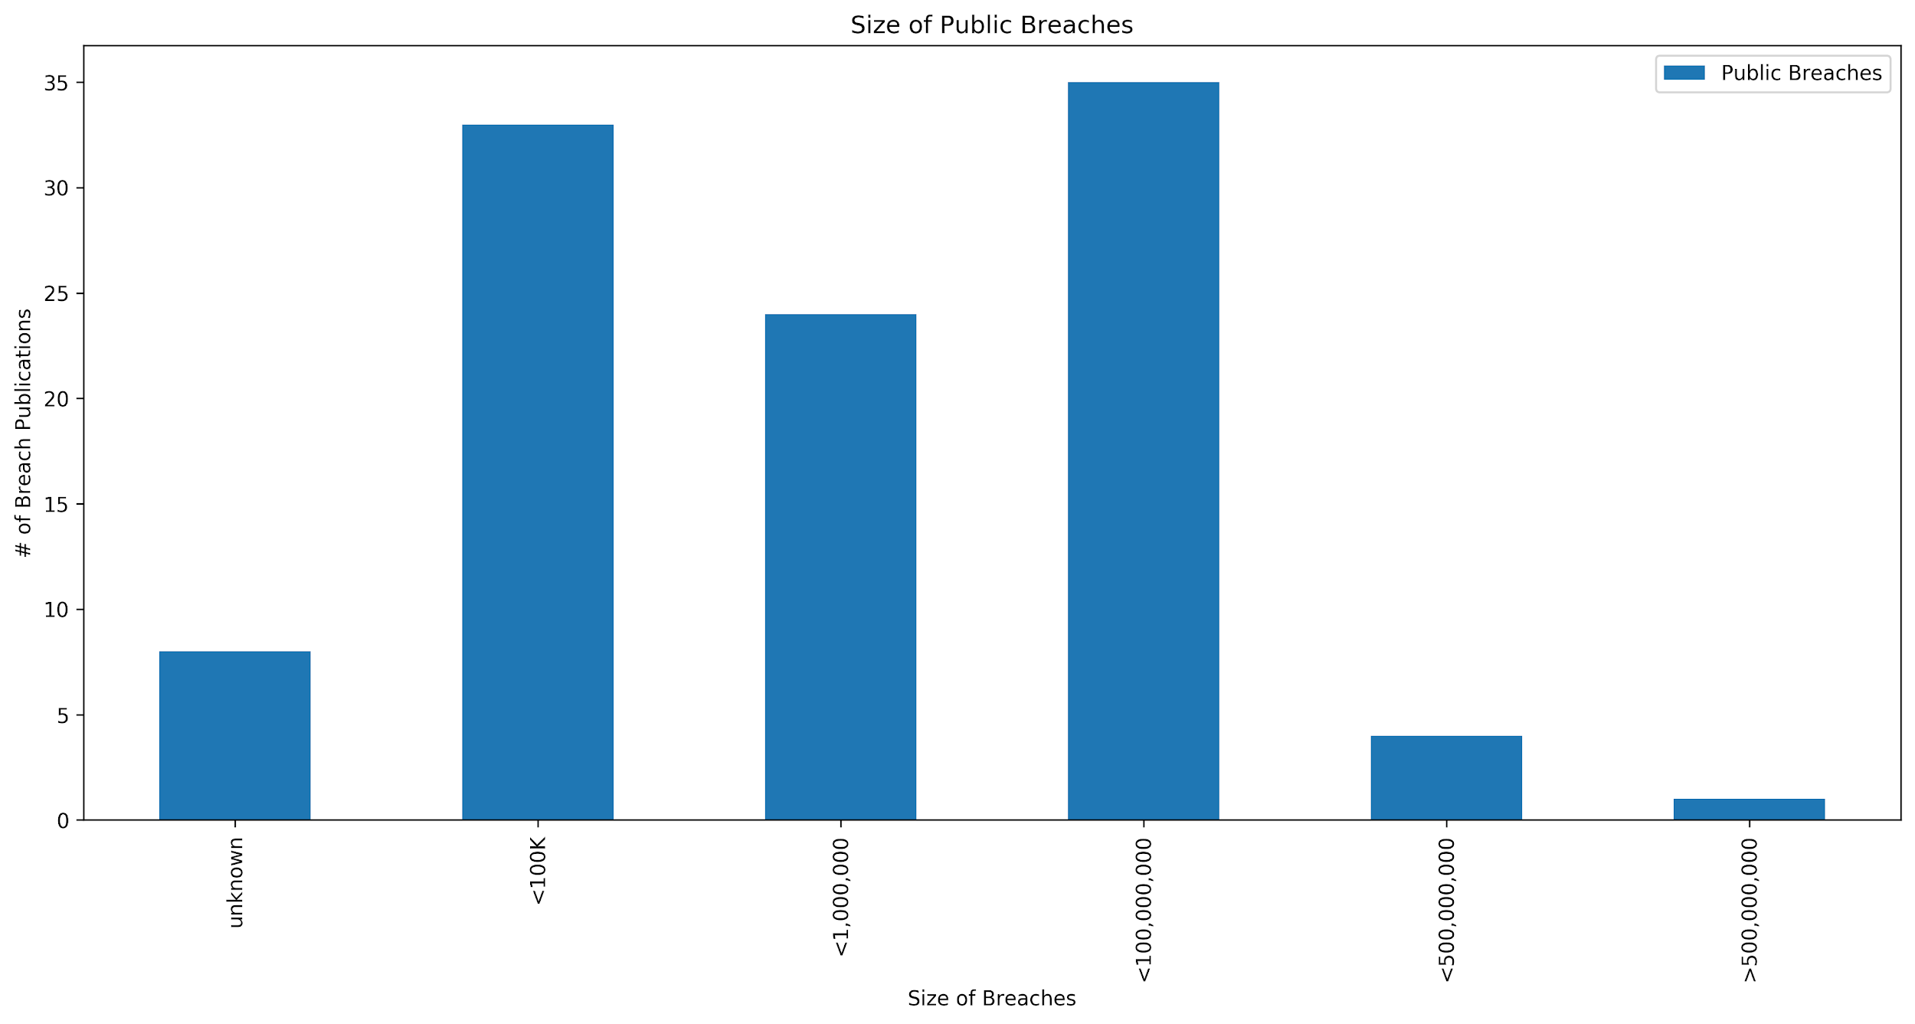
Between 1M and 100M is the most common breach
Total records breached from samples:
3,587,987,895
Unknown | <100K | <1,000,000 | <100,000,000 | <500,000,000 | >500,000,000
8 | 33 | 24 | 35 | 4 | 1

Slide 16
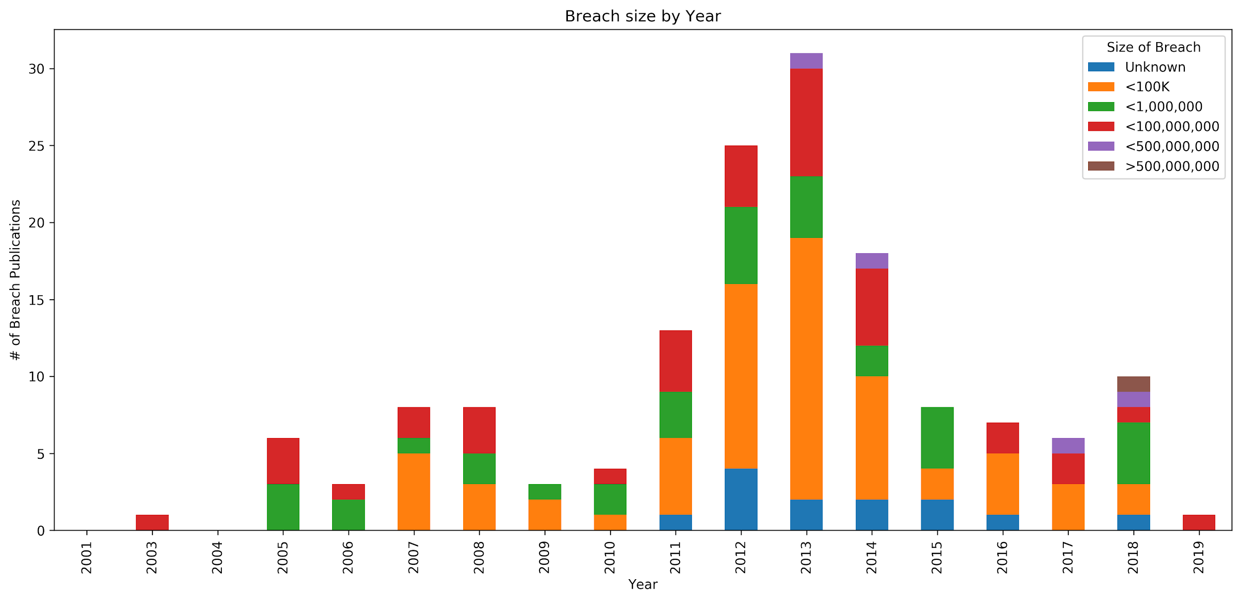
We see breach size start to increase on average.

Slide 17
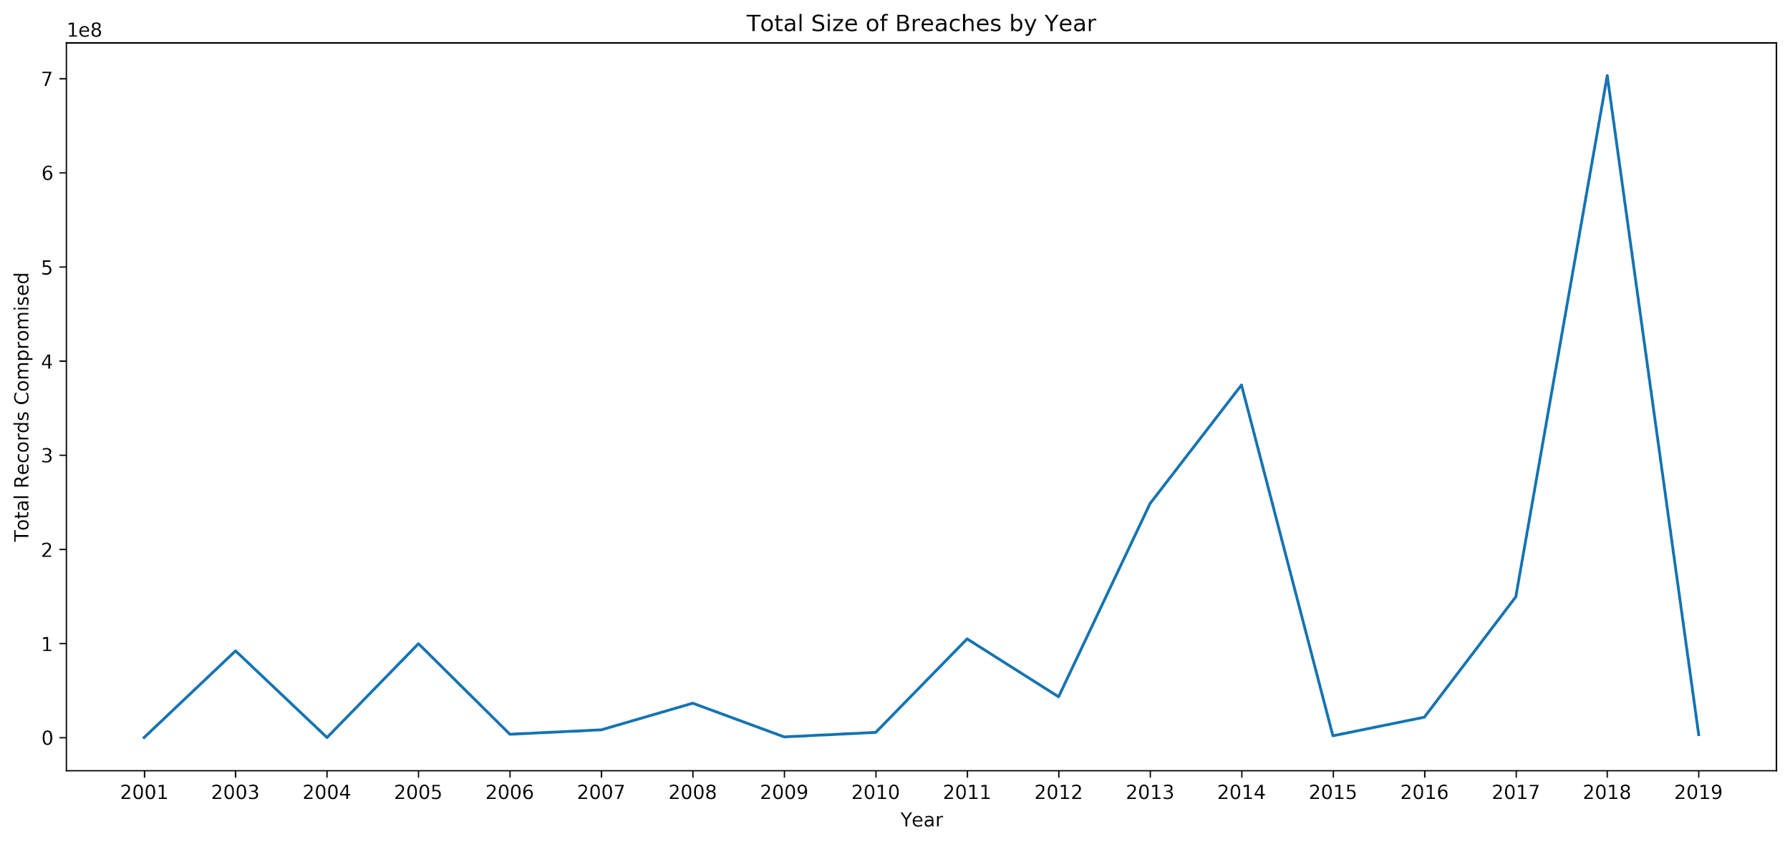

Slide 18
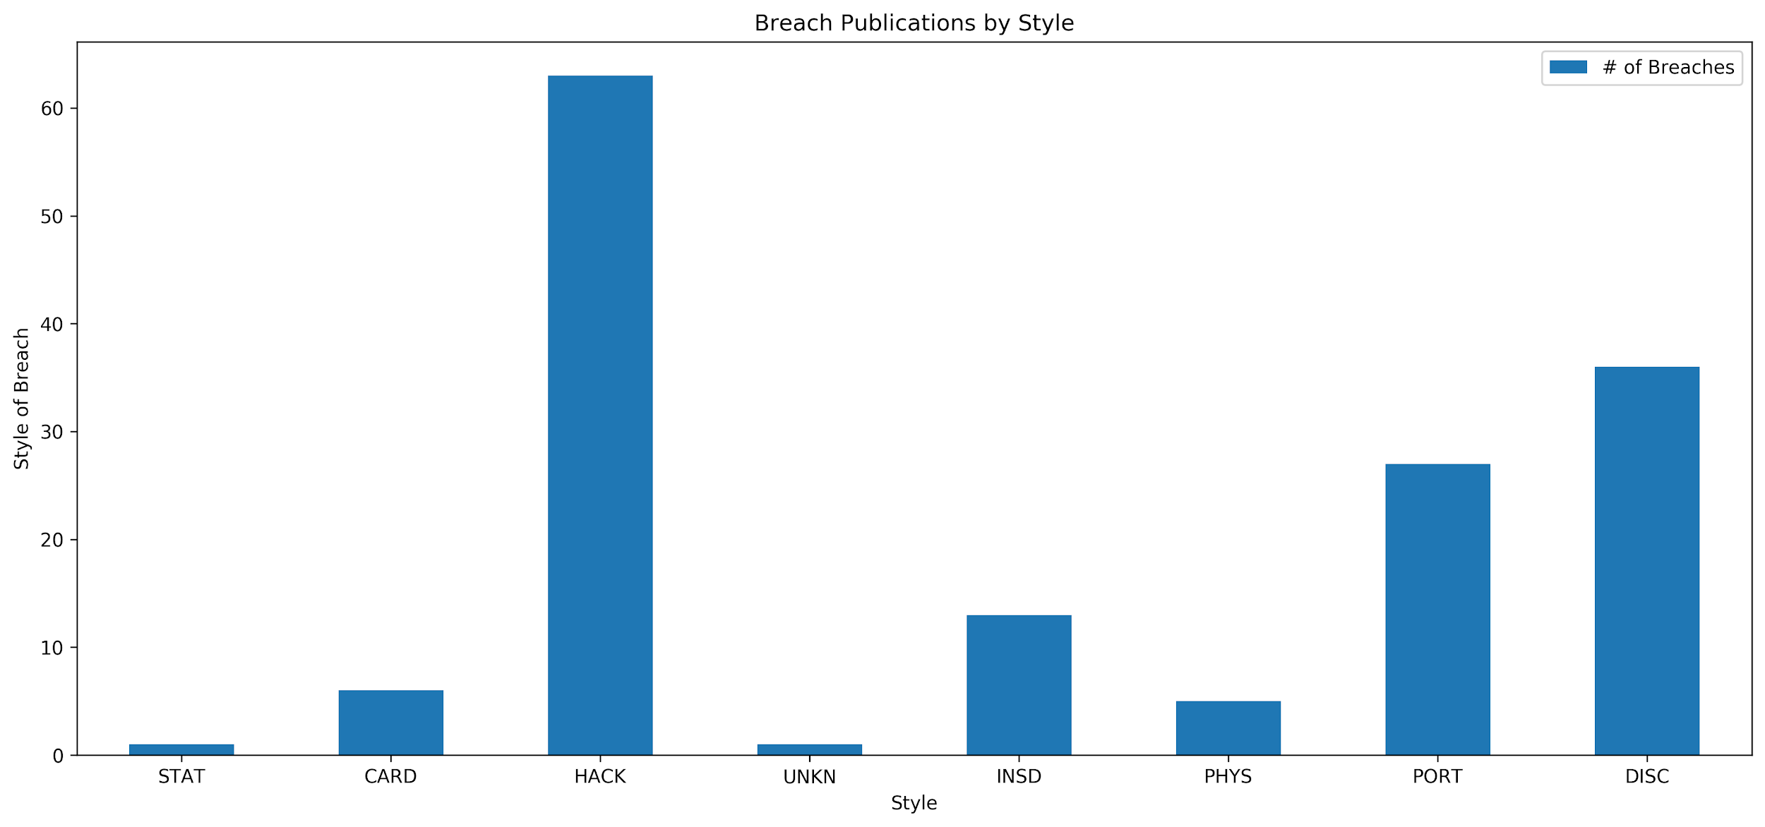
By far the most common issue (~41%)
~18% of breaches are caused by losing portable devices
STAT | CARD | HACK | UNKN | INSD | PHYS | PORT | DISC
1 | 6 | 63 | 1 | 13 | 5 | 27 | 36

Slide 19
Downloading the Stock Data
Previously:
Lack of sources
Used alphavantage.co
Missing data
Speed Limitation
Now:
Used Financial Modeling Prep
Free API
Better data
No speed limitations
Used investing.com (manually downloaded and formatted)

Slide 20
Naive Results
 | Stock Change | NASDAQ Change | NASDAQ Adjusted
Avg | -0.013% | 0.069% | -0.082%
Med | 0.157% | 0.007% | 0.041%
StdD | 2.094% | 1.129% | 1.818%
Market Adjusted = (((Company prices on day X after breach)/(Company price on day prior to breach)-1)*100) - (((MARKET prices on day X after breach)/(MARKET on the day prior to breach)-1)*100)
 | Stock Change | NYSE Comp. Change | NYSE Comp. Adjusted
Avg | -0.013% | 0.012% | -0.024%
Med | 0.157% | 0.000% | 0.040%
StdD | 2.094% | 0.947% | 2.269%

Slide 21
Longer Term
 | 1 Week Market Adjusted | 2 Week Market Adjusted | 1 Month Market Adjusted | 1 Year Market Adjusted* | 2 Year Market Adjusted**
Avg | -0.680% | -0.598% | -0.871% | -0.144% | 2.928%
Med | -0.181% | -0.296% | -2.044% | -5.182% | -5.862%
StdD | 5.166% | 5.697% | 9.258% | 31.291% | 49.773%
* The following could not included: AET, TM
** The following could not included: AET, CNO, GDDY, FB, GOOGL, JWN, TM, MAR, EXPE, CM, UAA

Slide 22
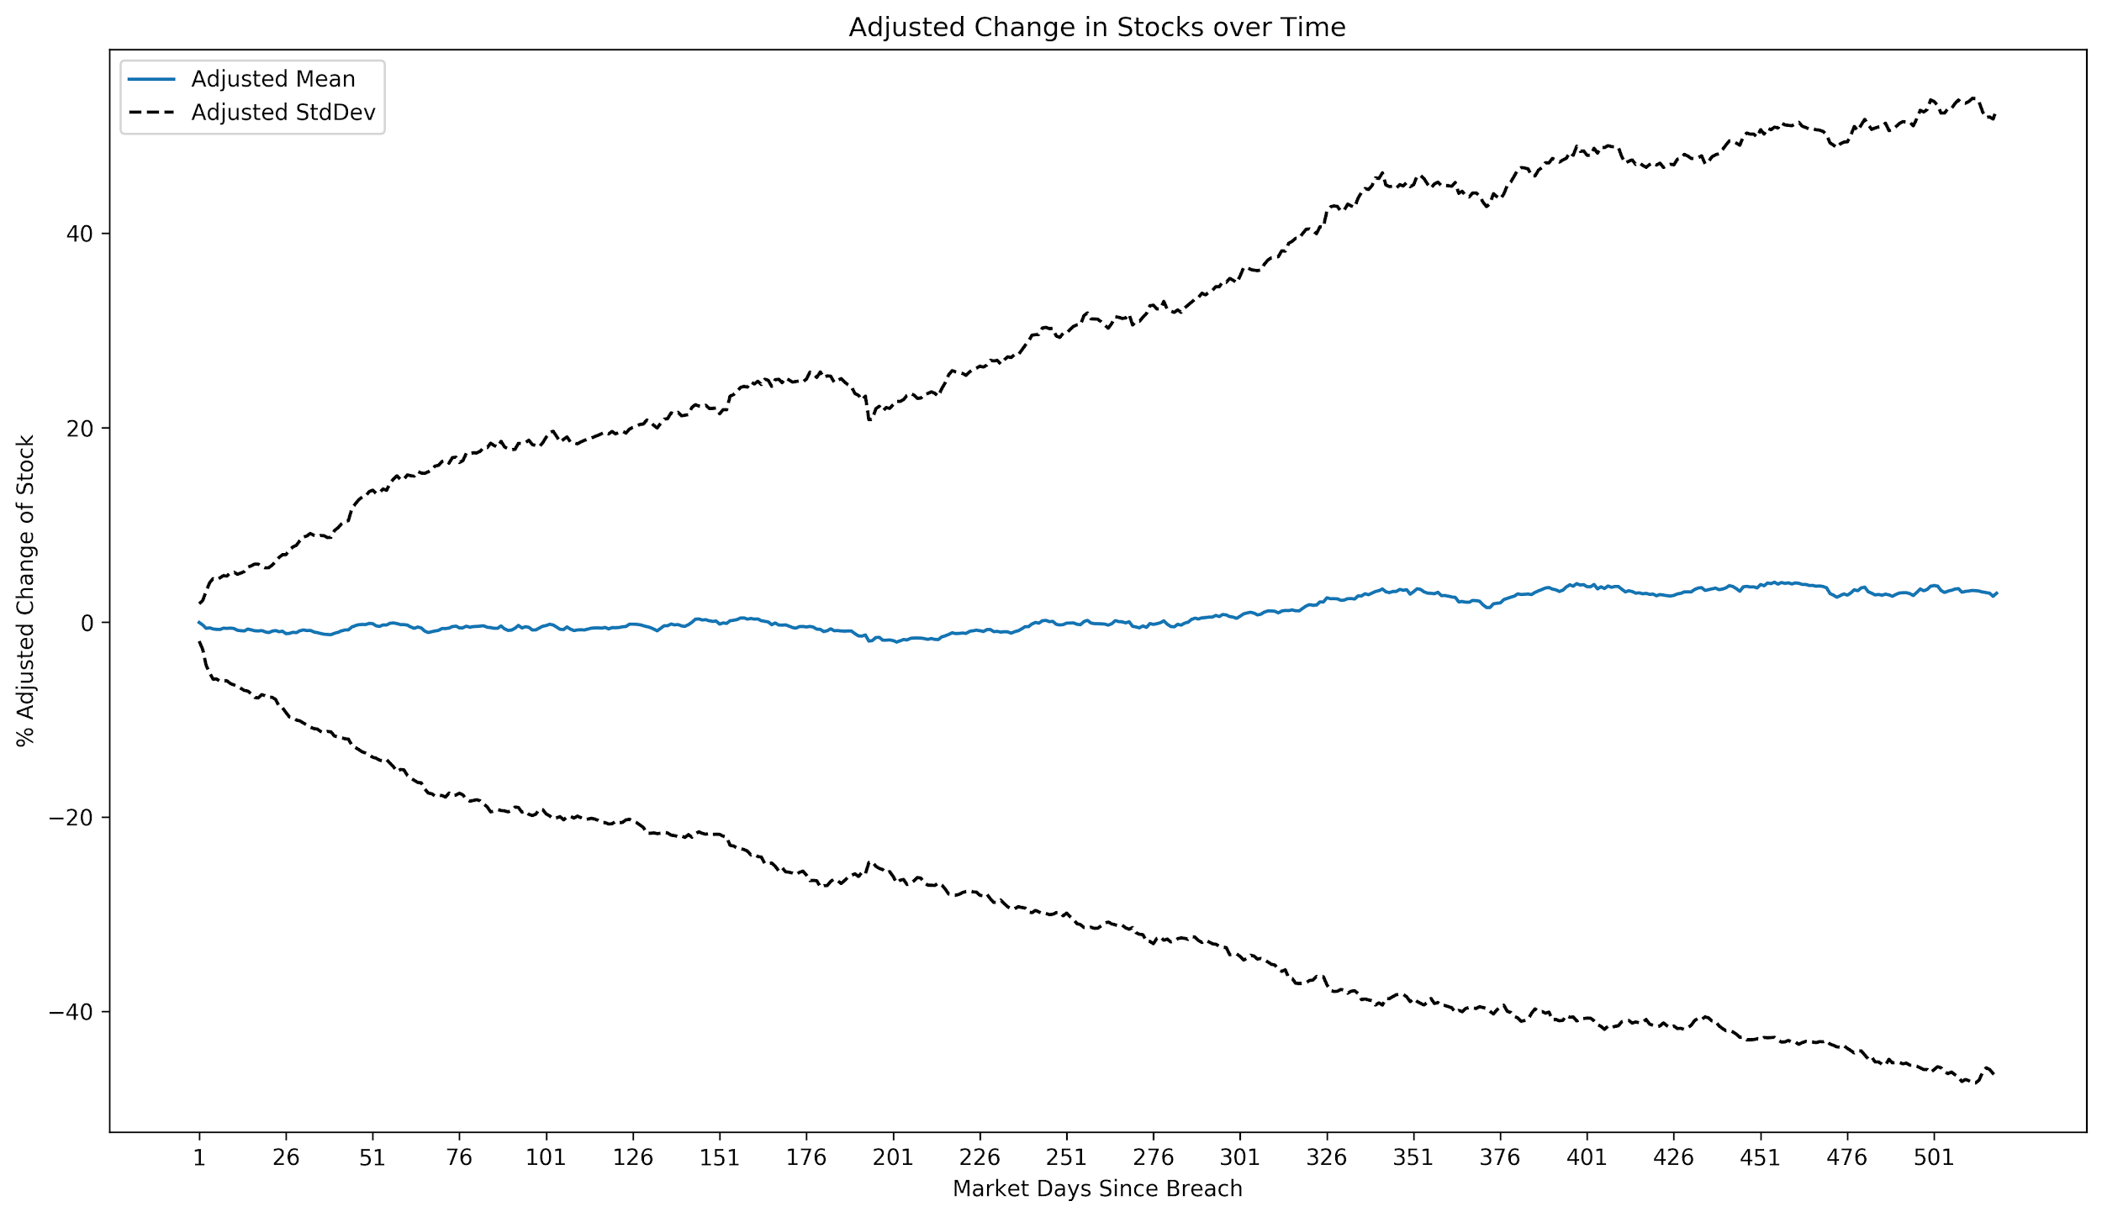
Even at the beginning, our StdDev is too high.
If you’re considering buying for Long Term Capital Gains… Don’t

Slide 23
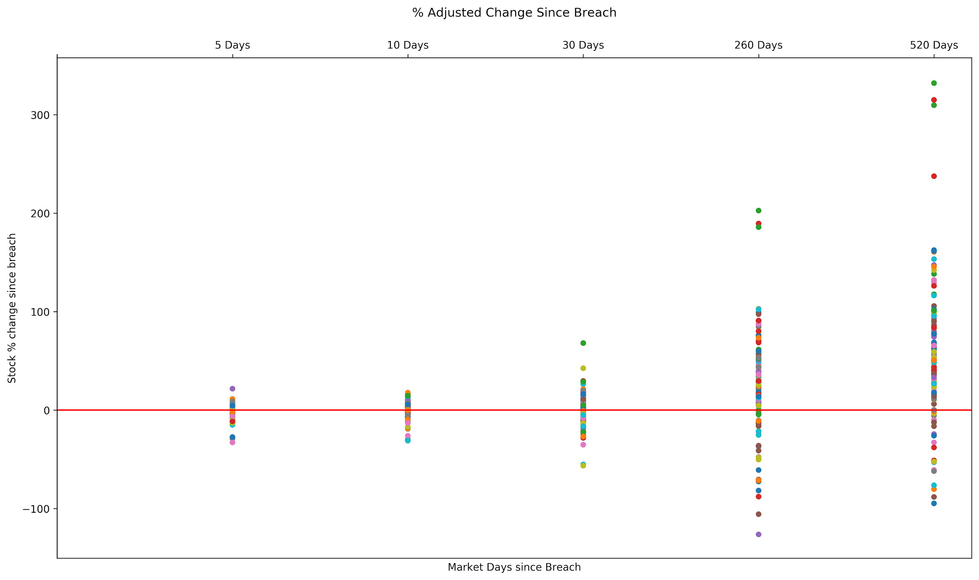
Let's zoom in on just the 15 day period

Slide 24
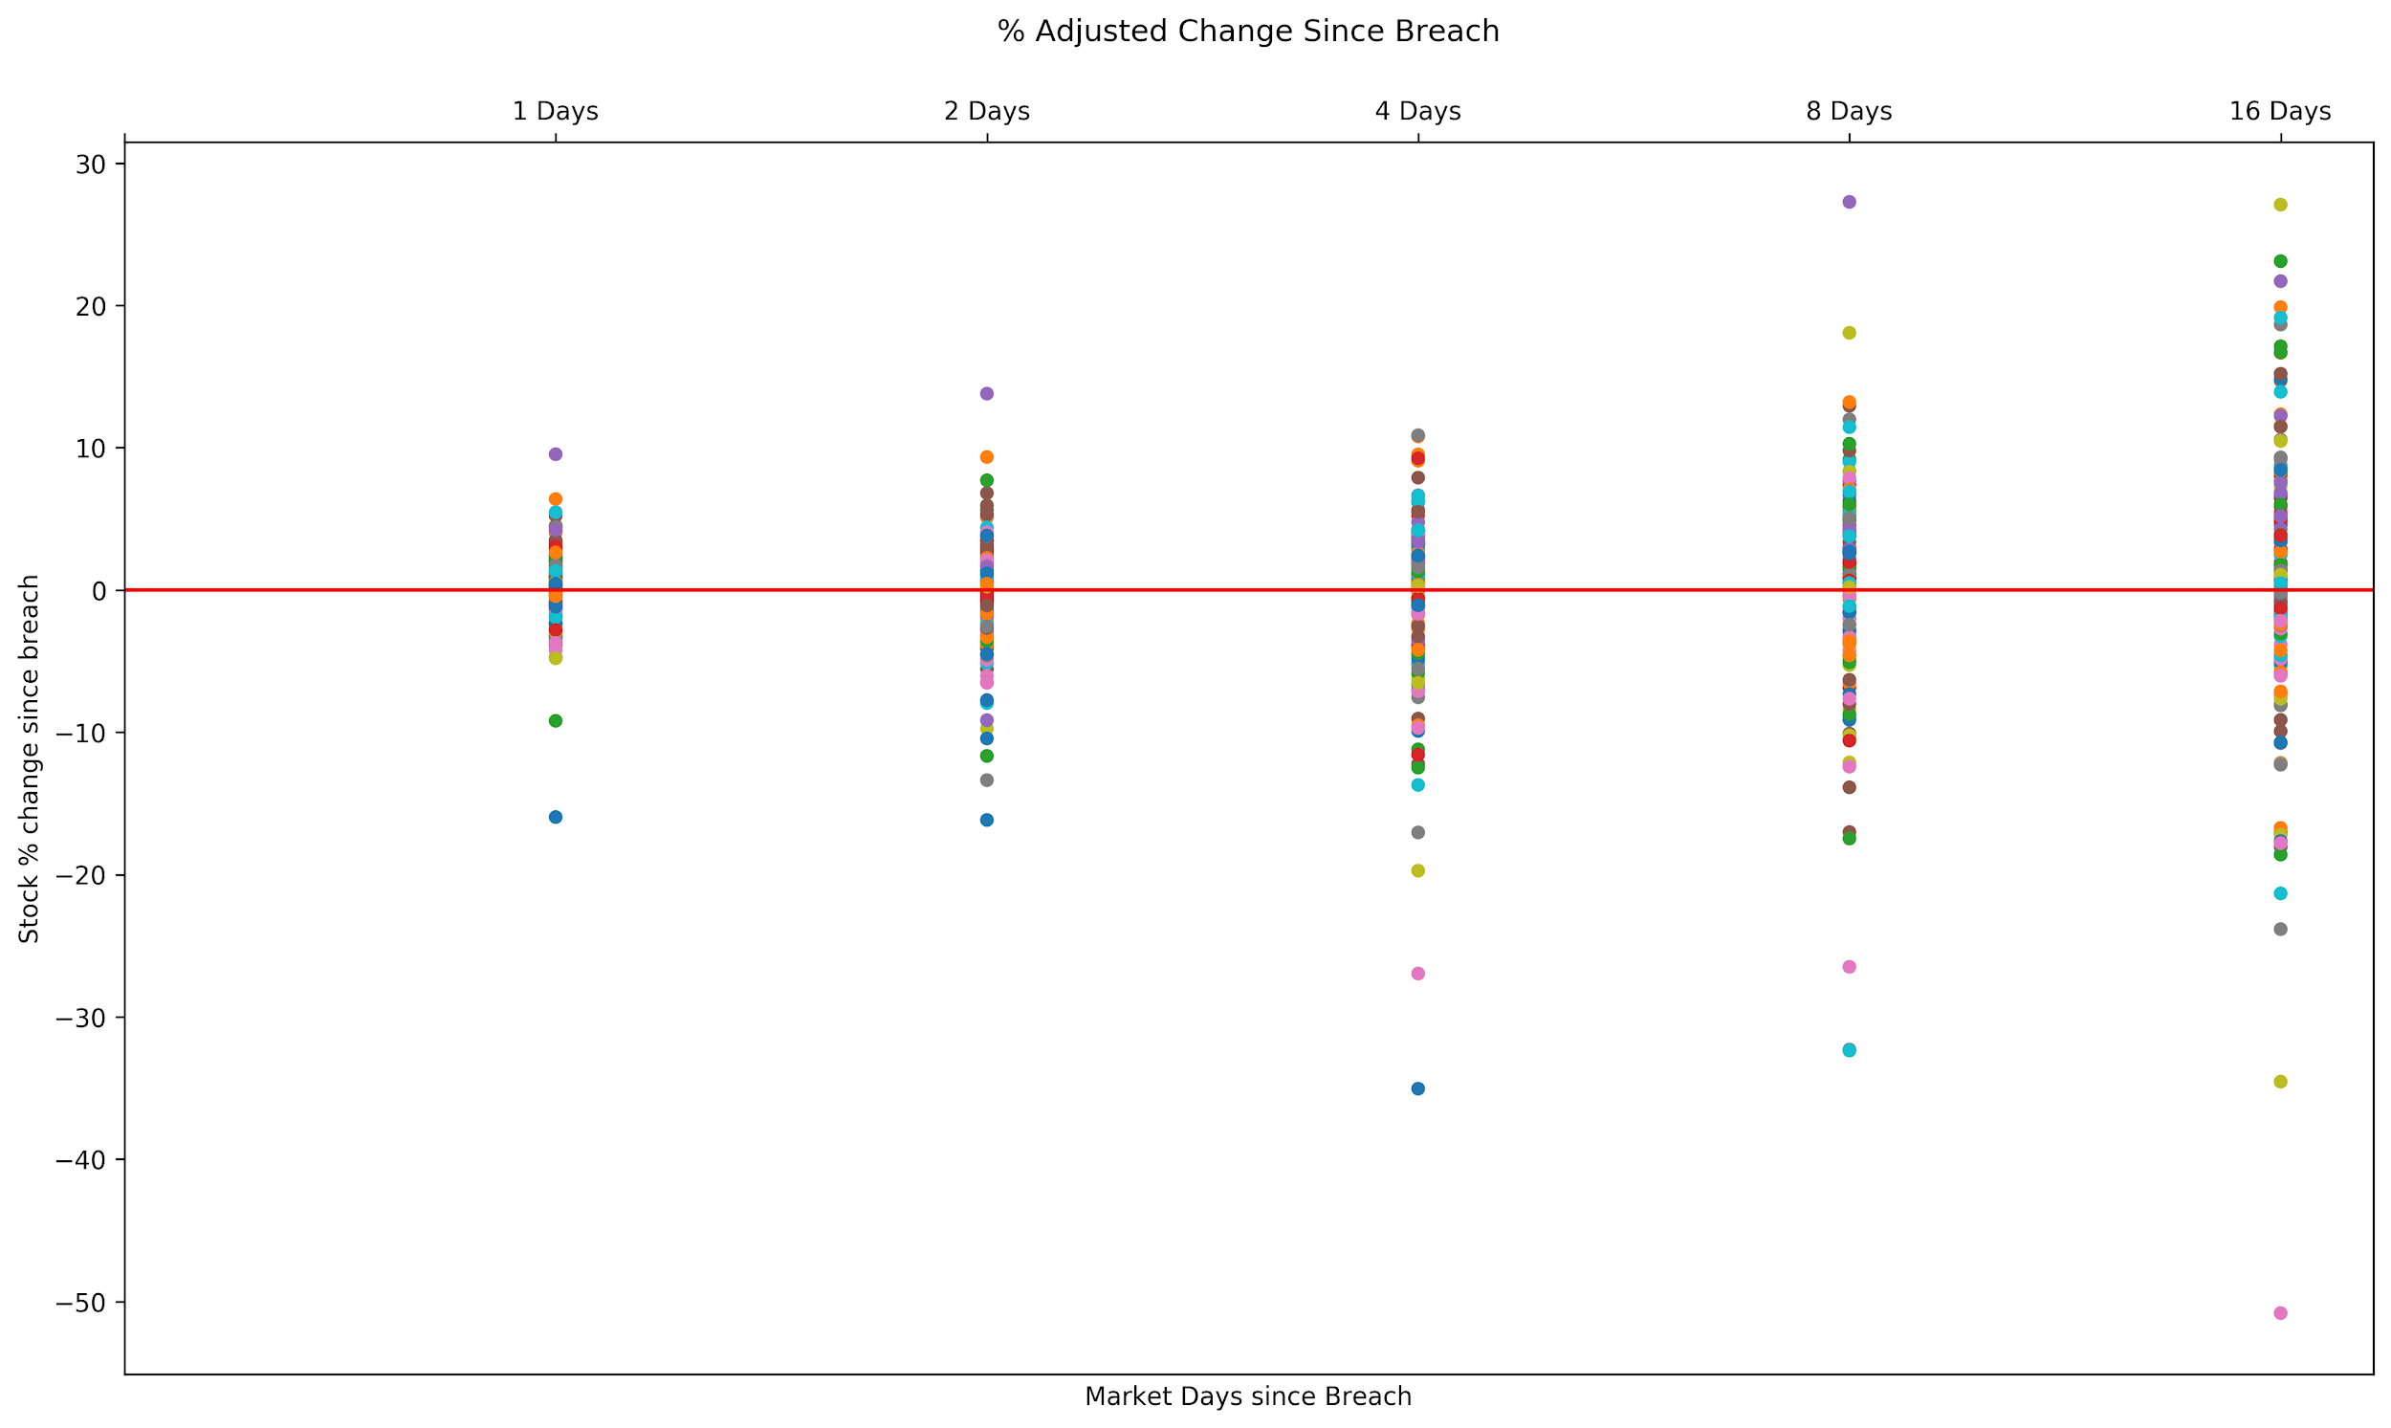
Notice that we’re seeing longer negative tails.
Somewhat clustered at the beginning

Slide 25
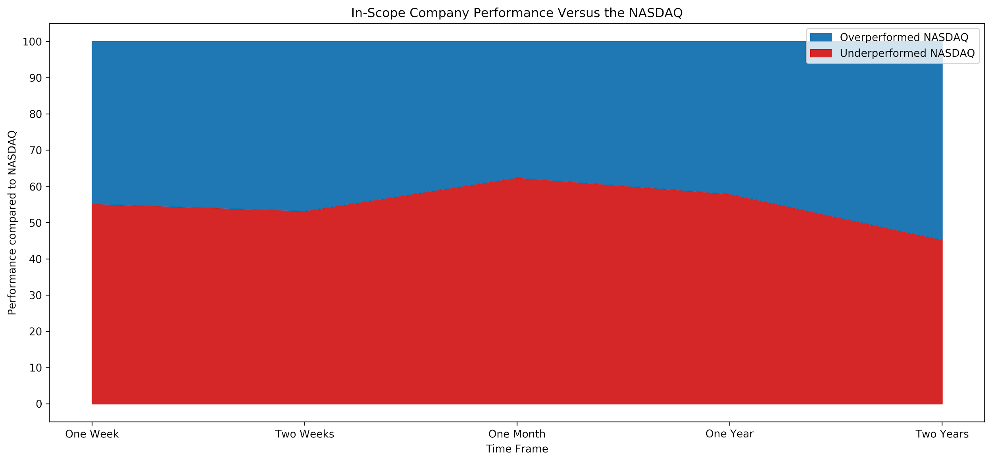
At this point 3/5s of firms are underperforming
 | One Week | Two Weeks | One Month | One Year* | Two Years**
Overperformed NASDAQ | 44.7% | 46.7% | 37.5% | 42% | 54.7%
Underperformed NASDAQ | 55.30% | 53.30% | 62.50% | 58% | 45.30%

Slide 26
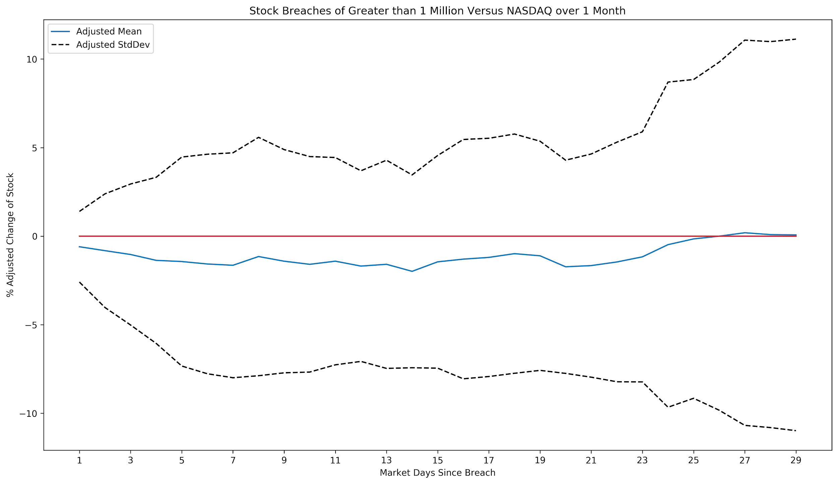

Slide 27
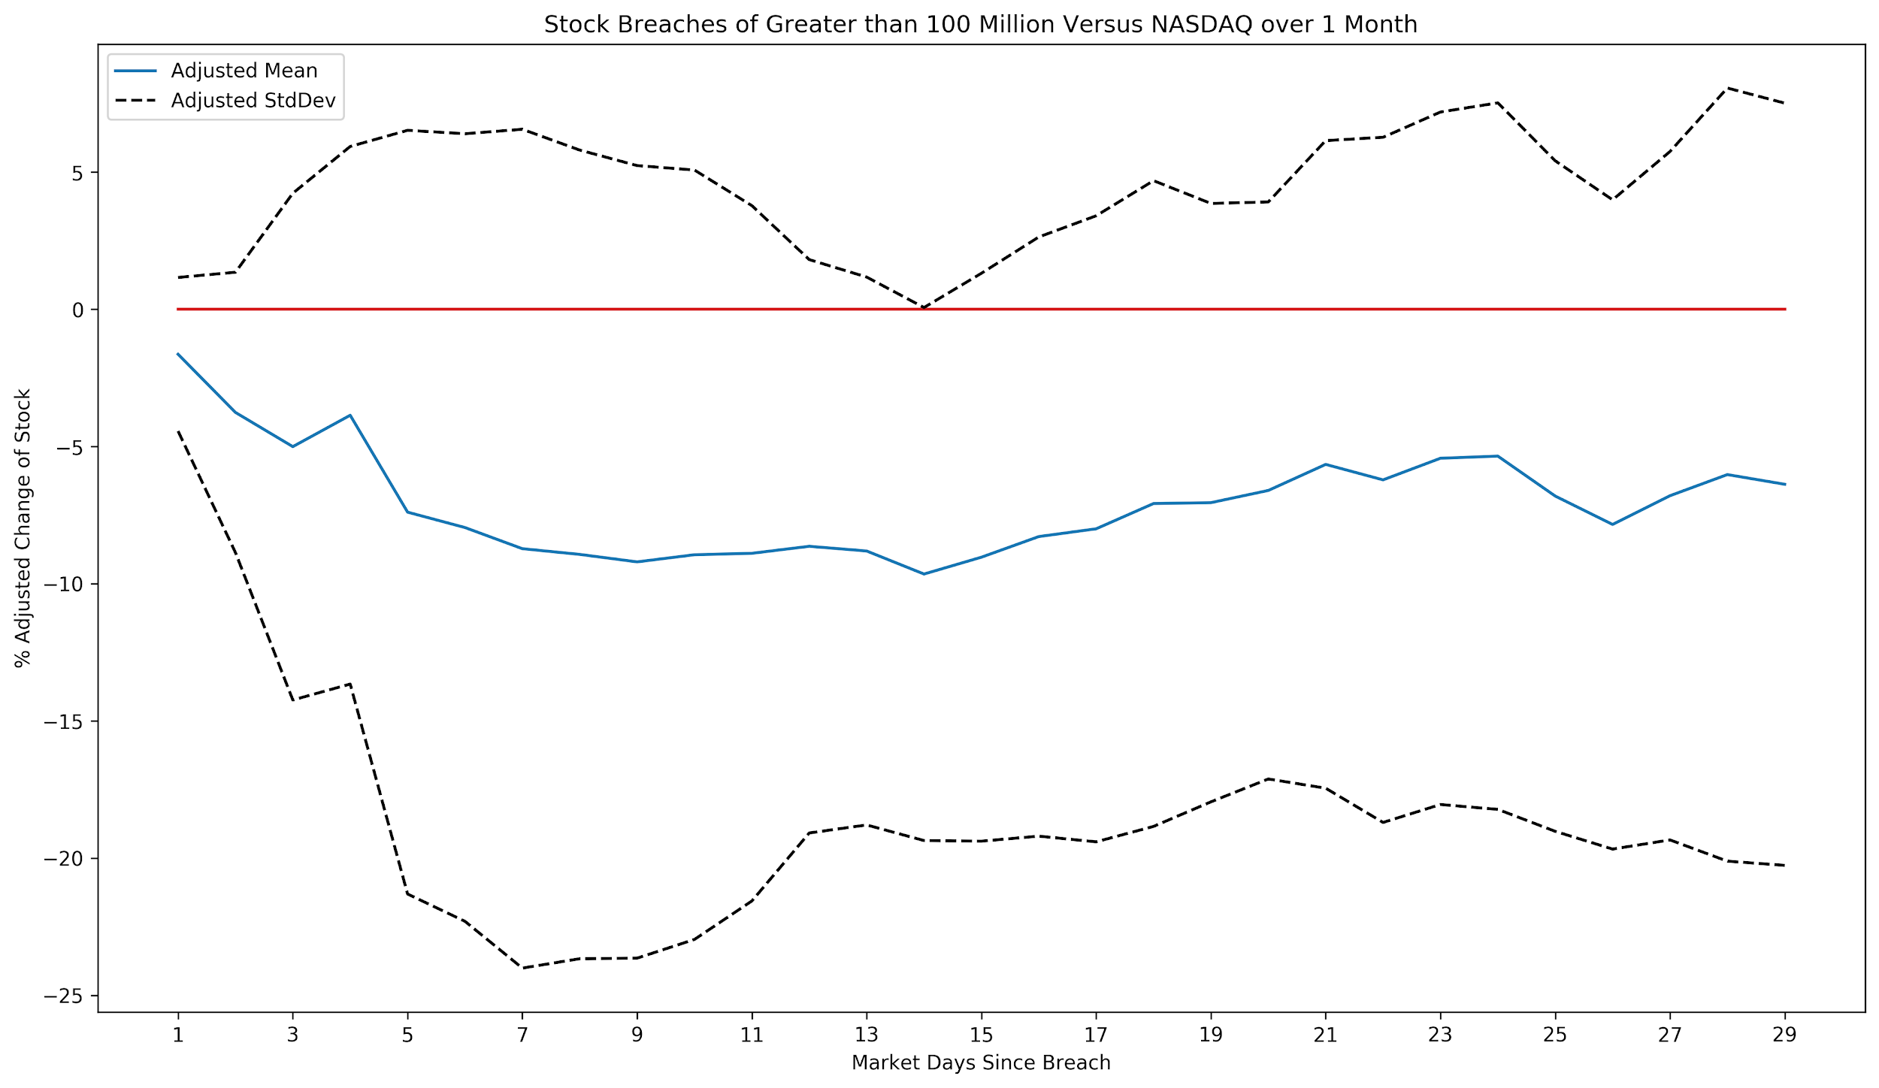
Finally, Marketable information!

Slide 28
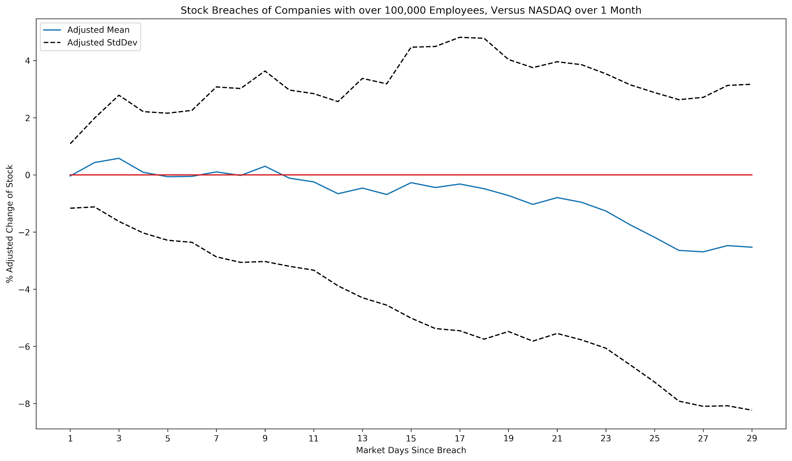

Slide 29
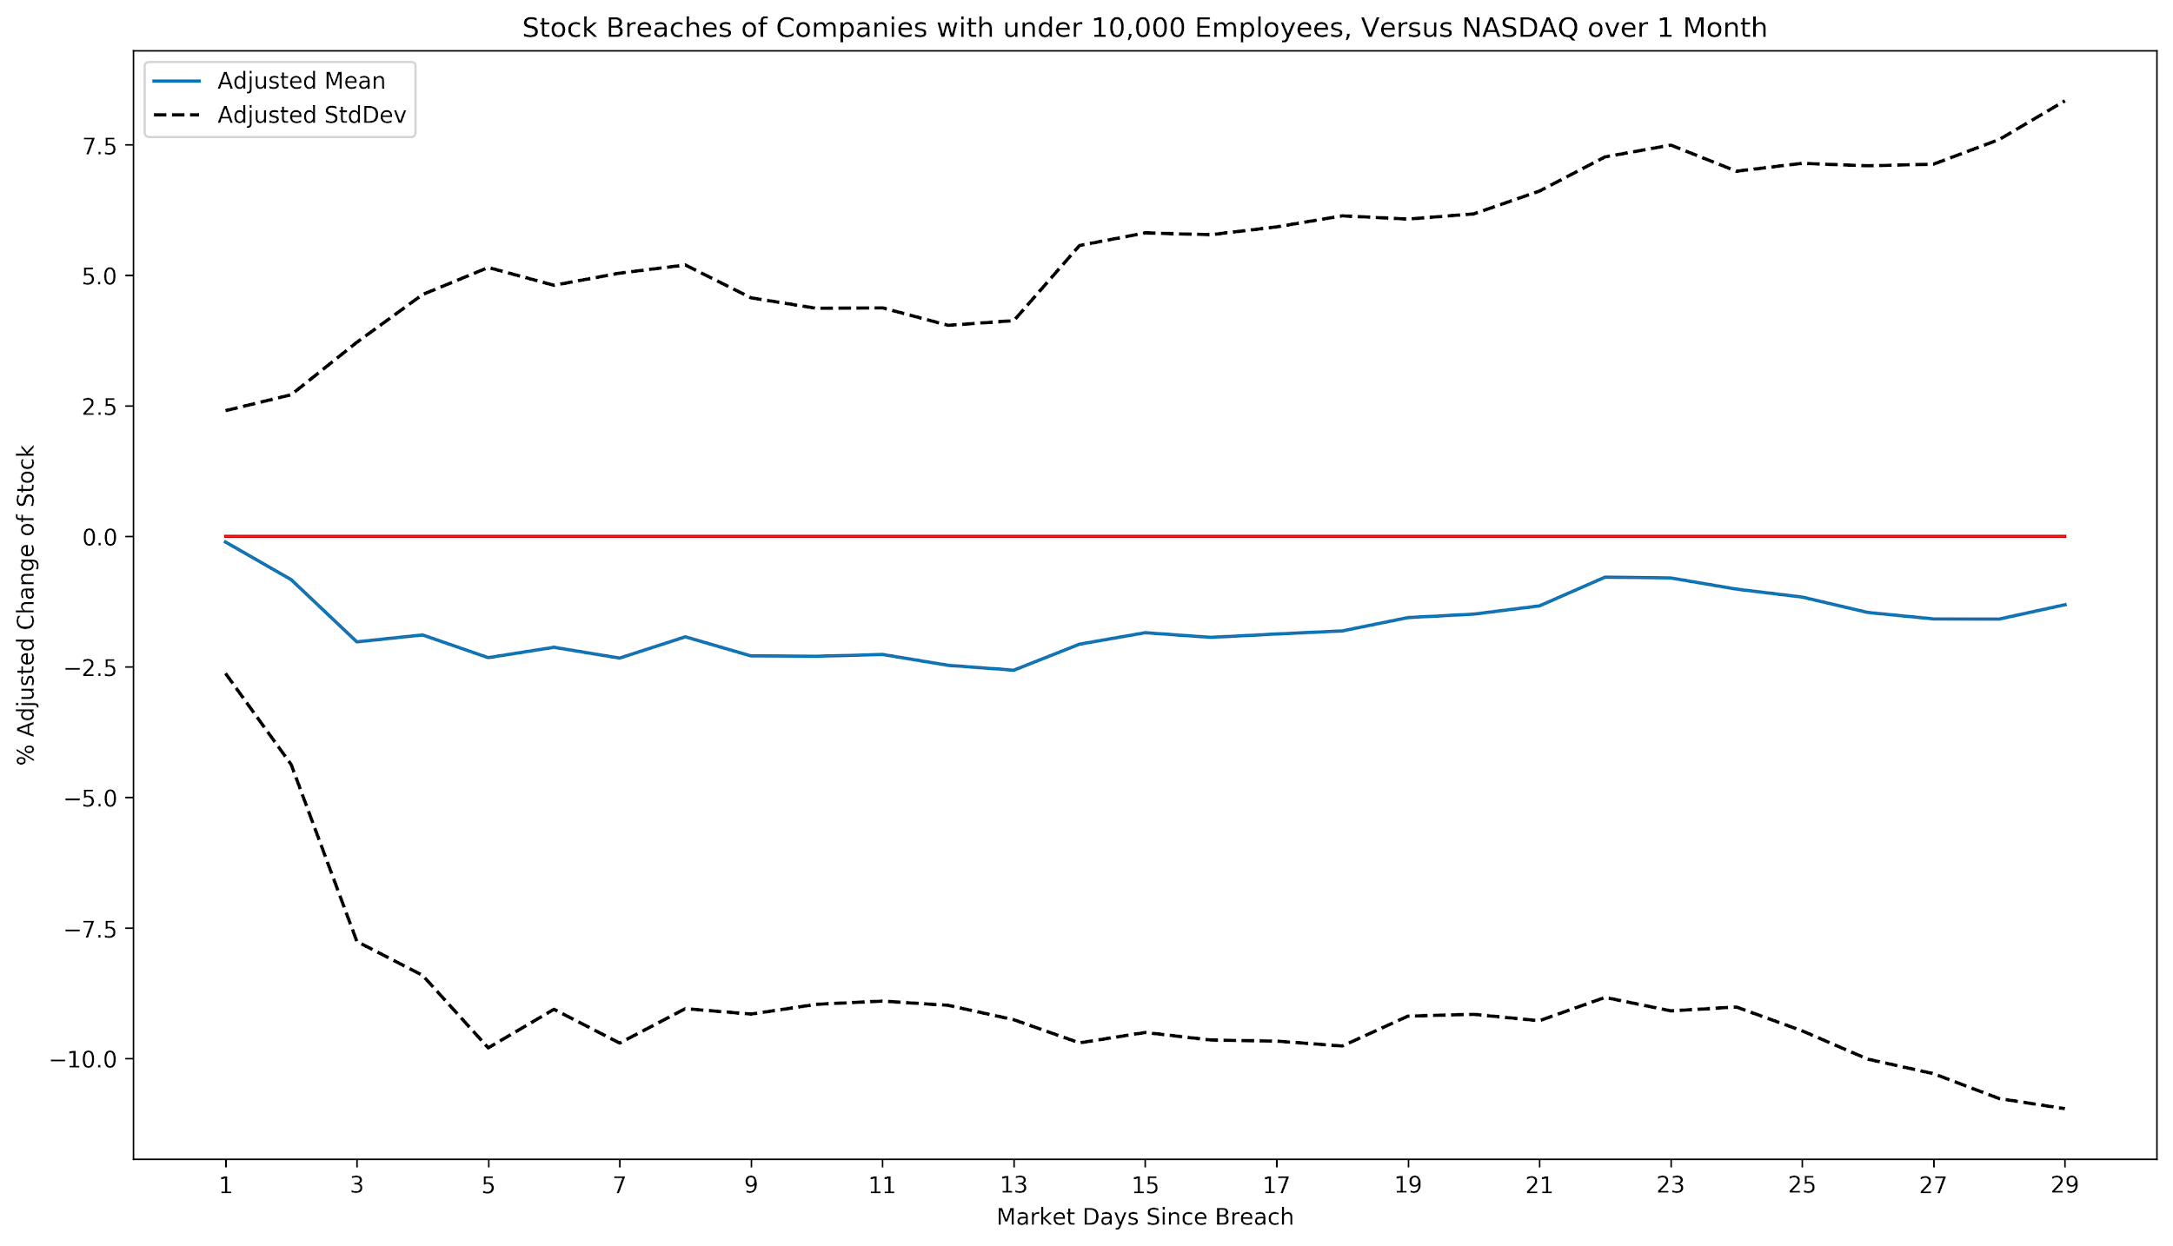

Slide 30
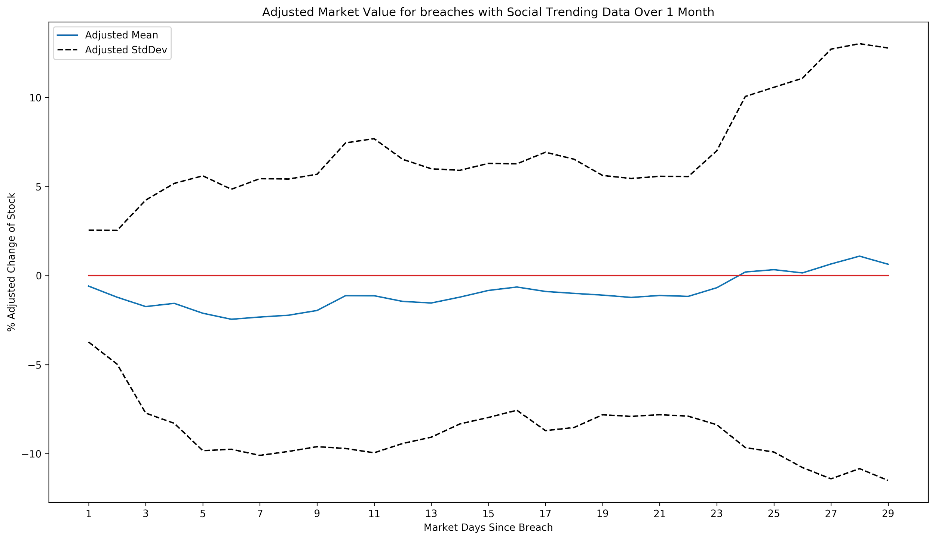

Slide 31
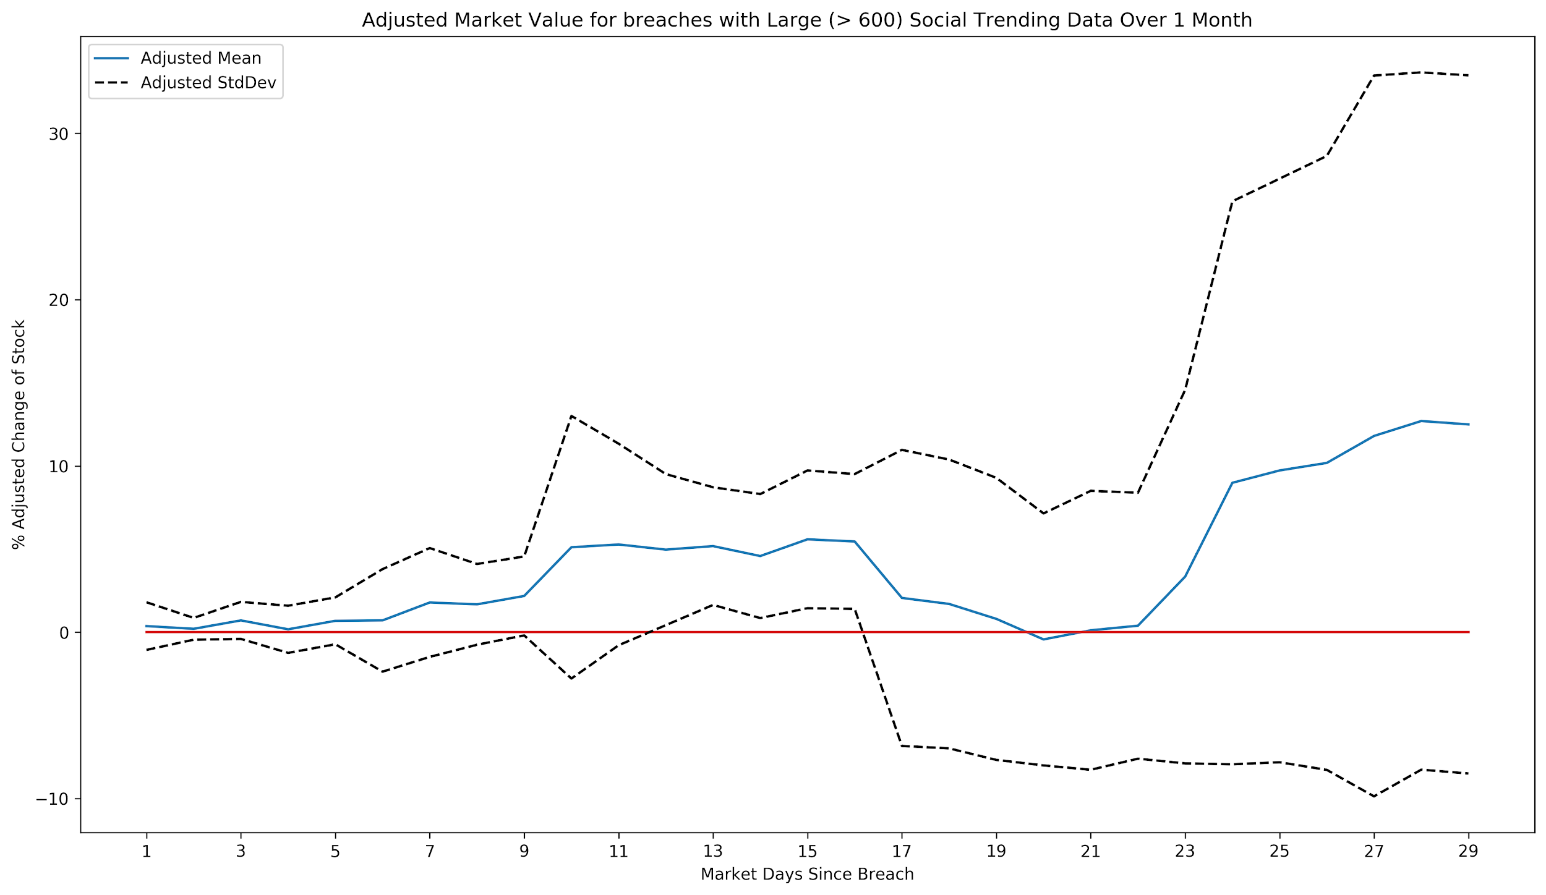

Slide 32
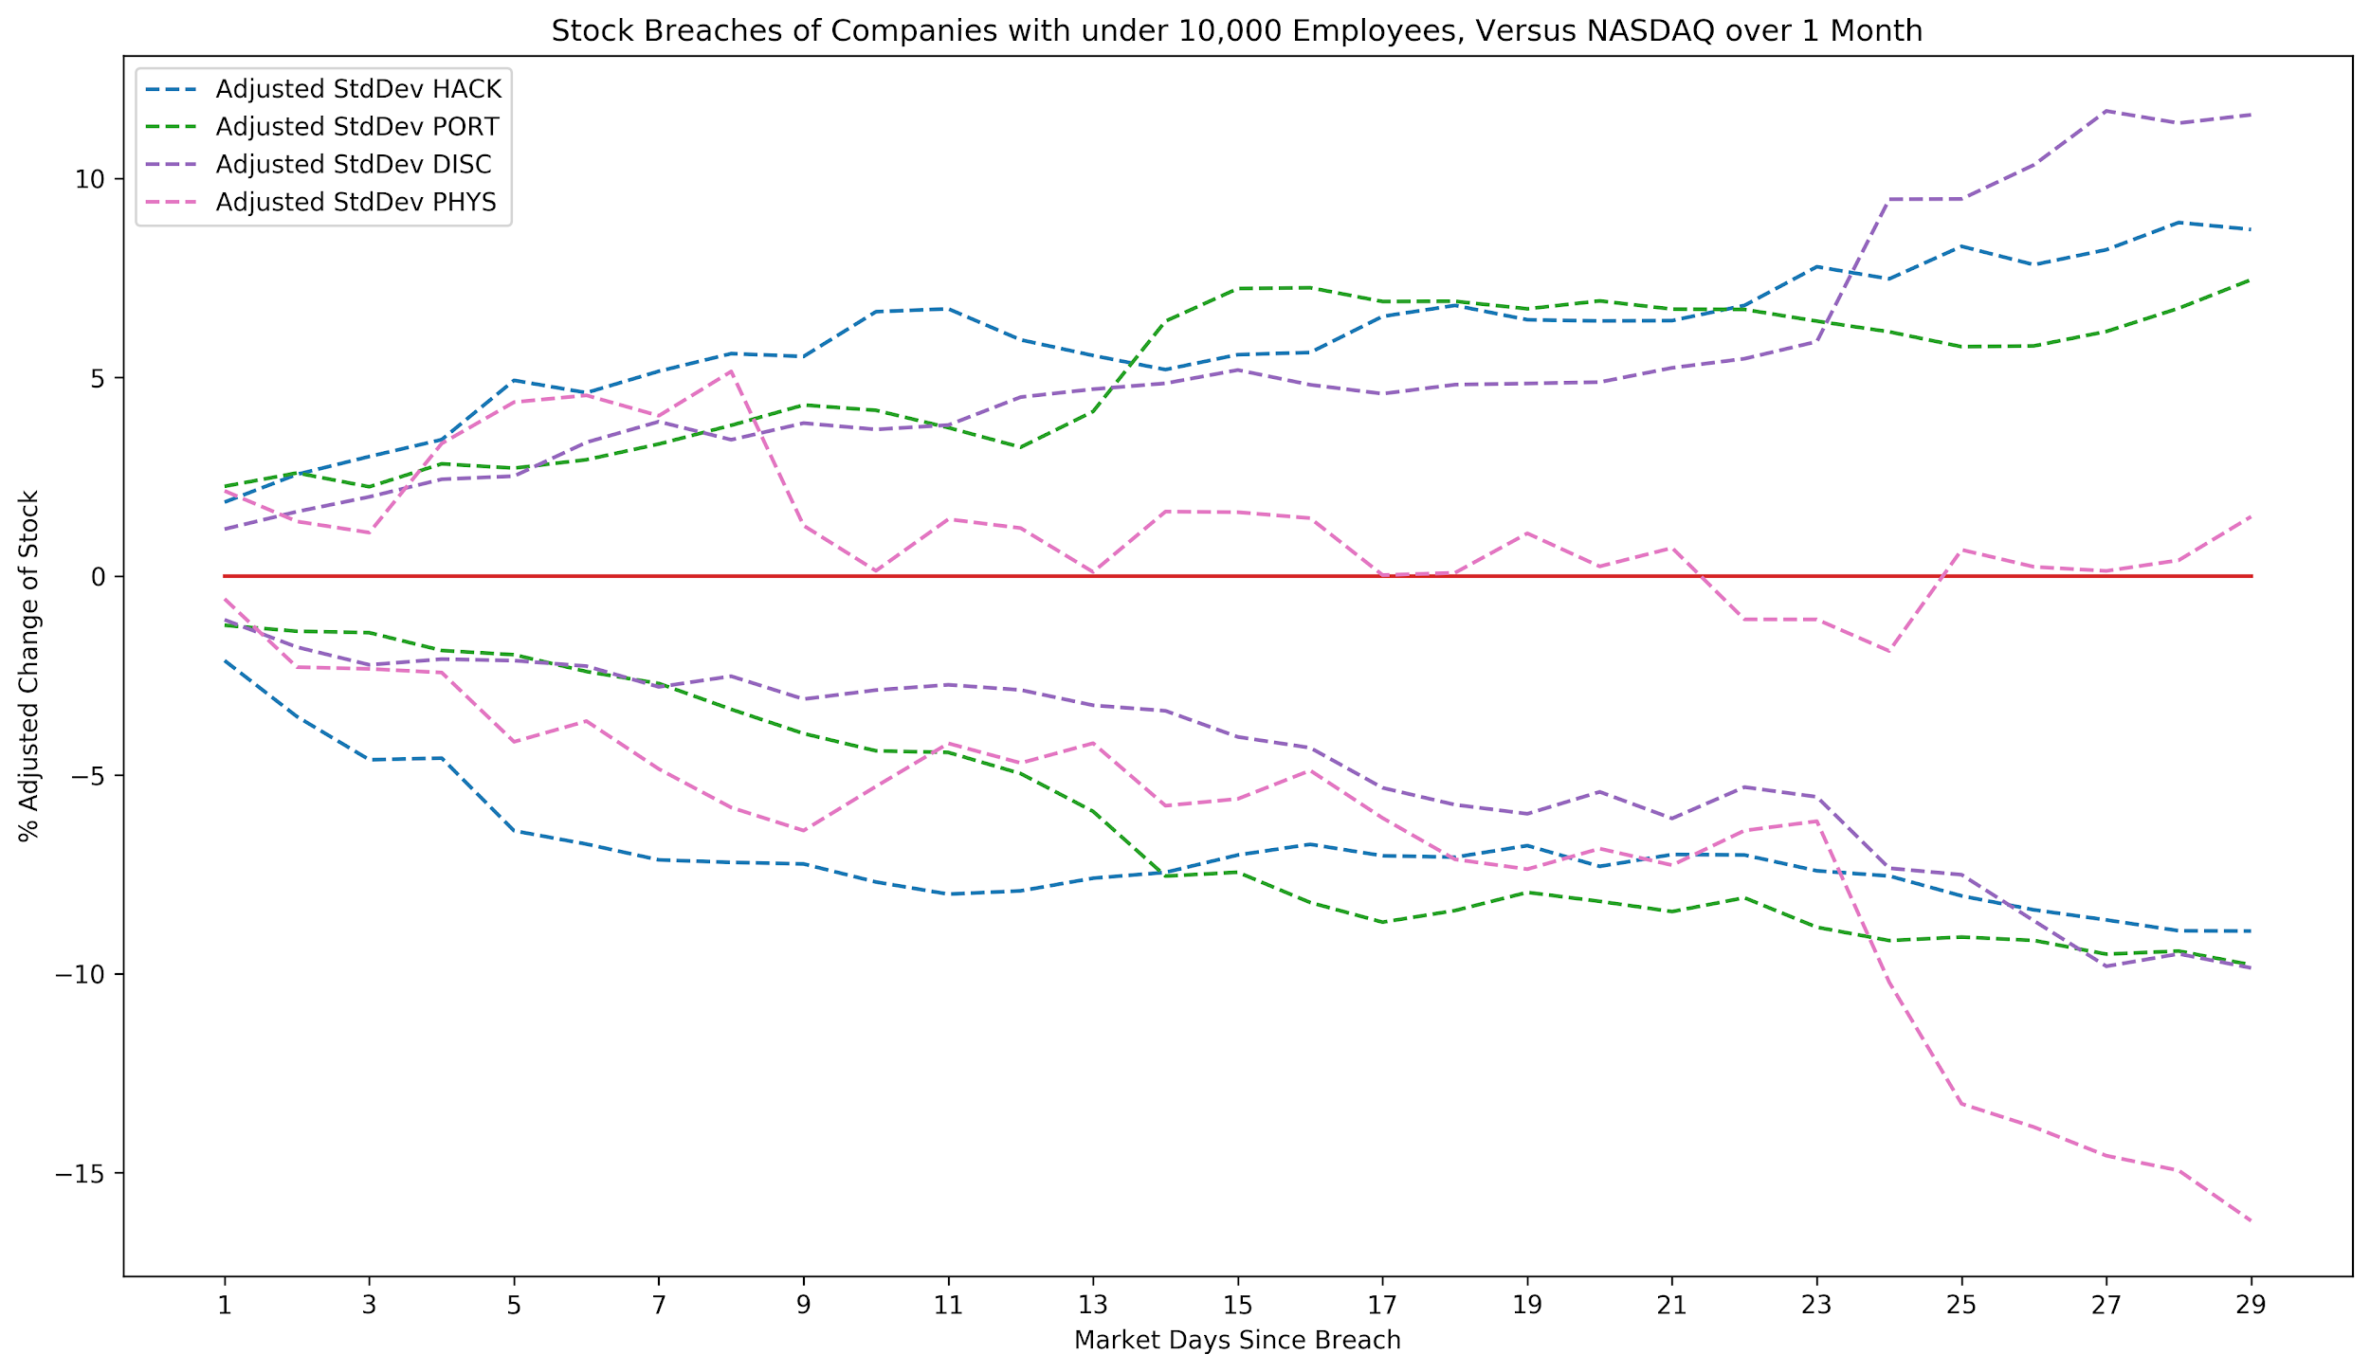
Hard to read but PHYS seems to be killing it.

Slide 33
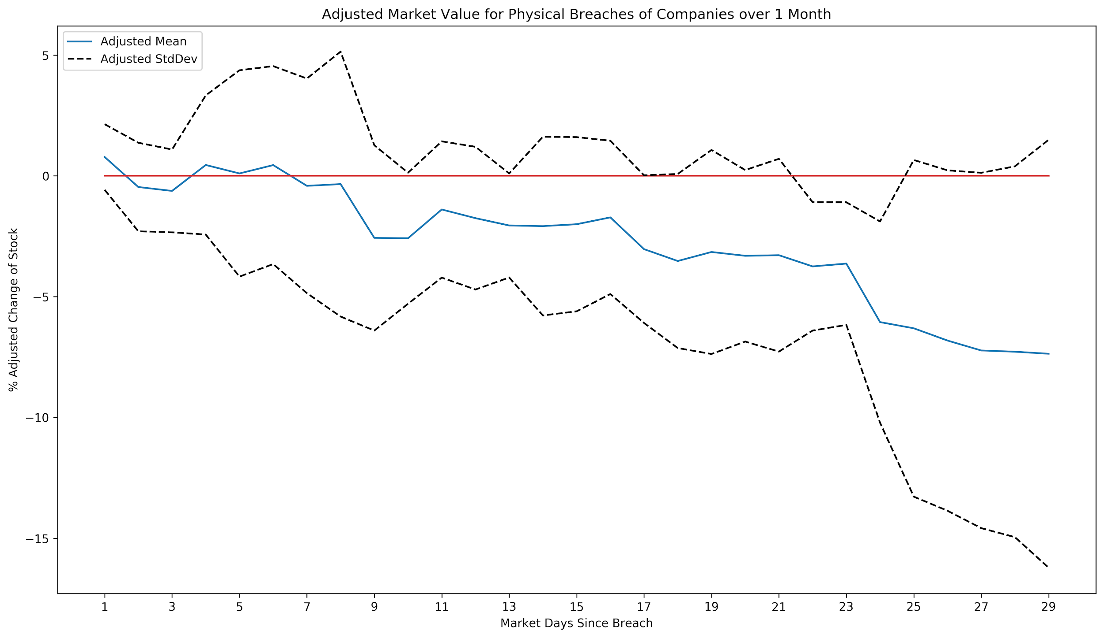
The bad news is that this only represents 5 samples

Slide 34
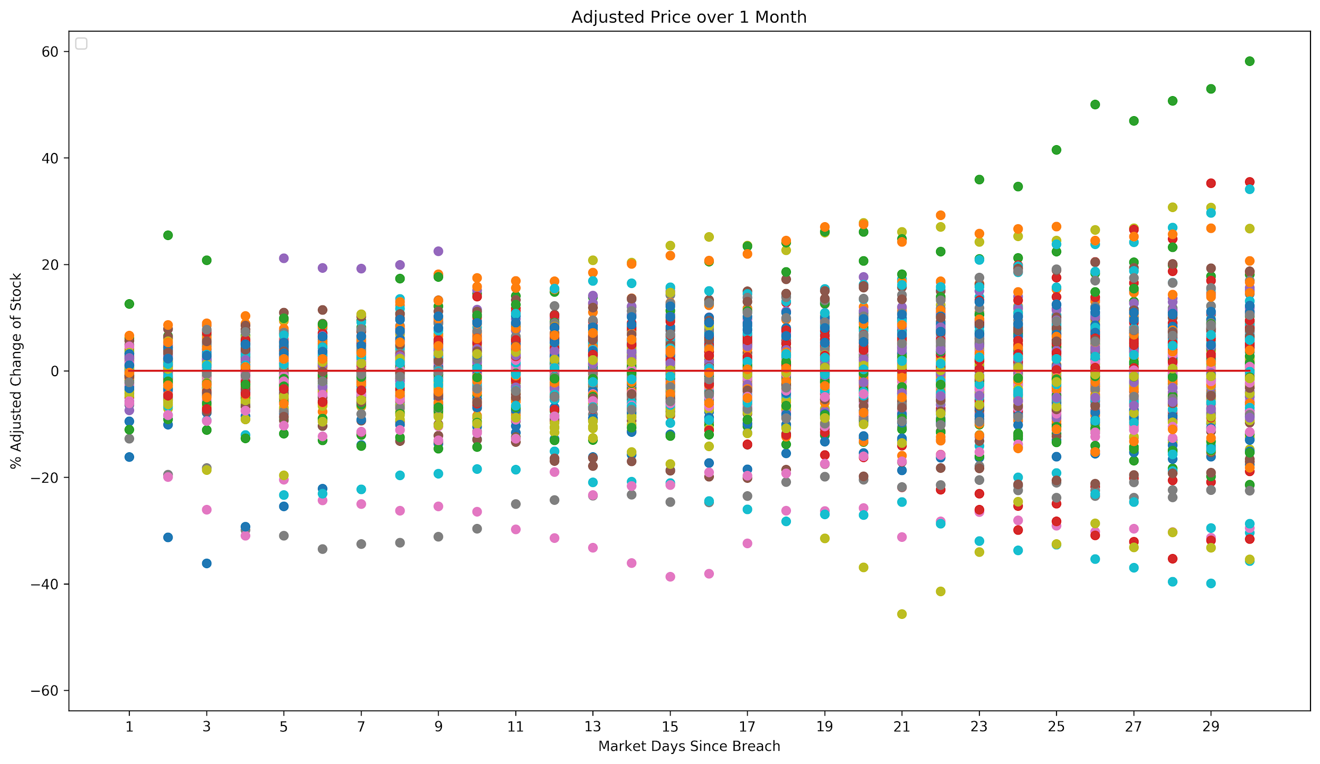
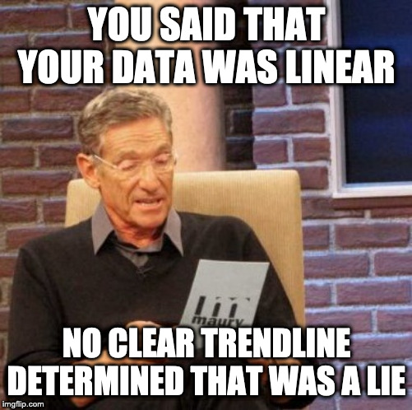
Predictive Models
Can we use Linear Regression?
Let’s check our data!

Slide 35

Multivariate Linear Regression - Anyway
Good R^2 for finance - 85%-100%
Our R^2 - 25%
Aspects of our Dummy Coefficients that had a larger than average impact
CARD style
STAT style
UNKN style
Day 6 of Month
Day 5 of Month
Day 18 of Month
Manufacturing Breaches
Month of November

Slide 36
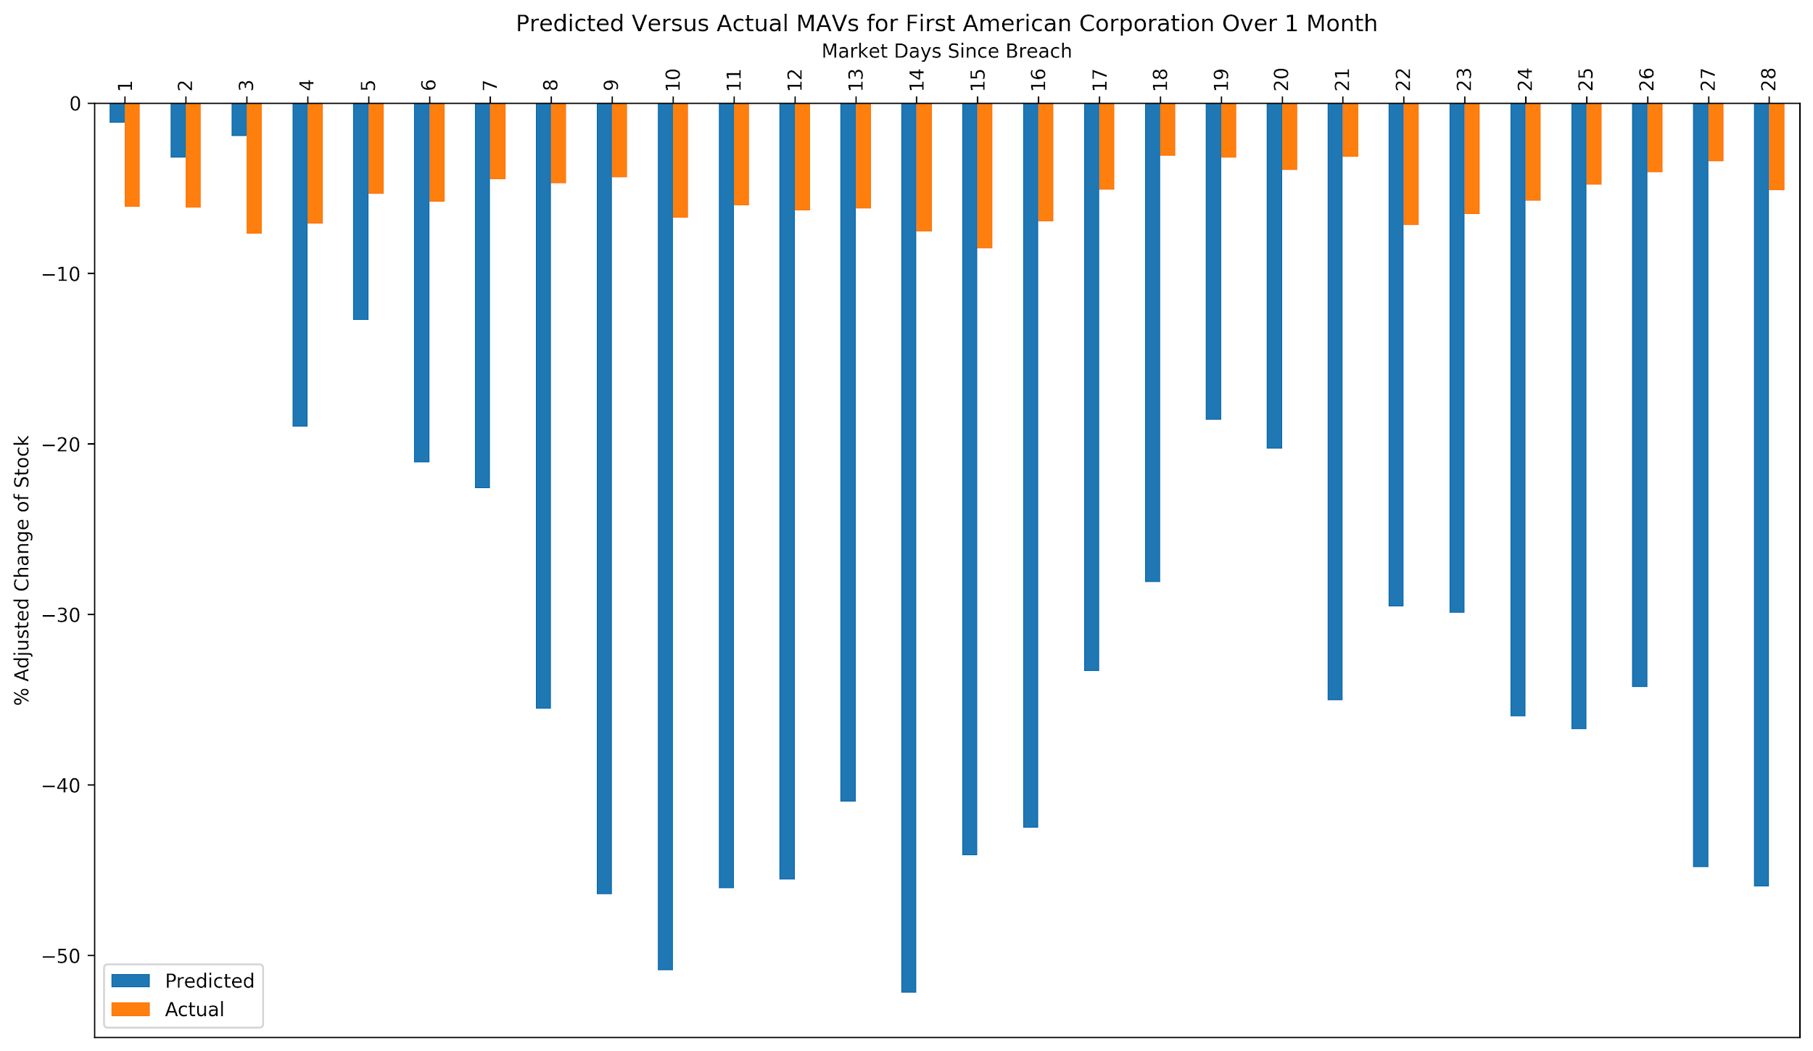
As predicted the results are … Bad

Slide 37
Non-Linear Predictions: Neural Nets
Multi-layer Perceptron regressor Using adam
R^2 approaching 62%

Slide 38
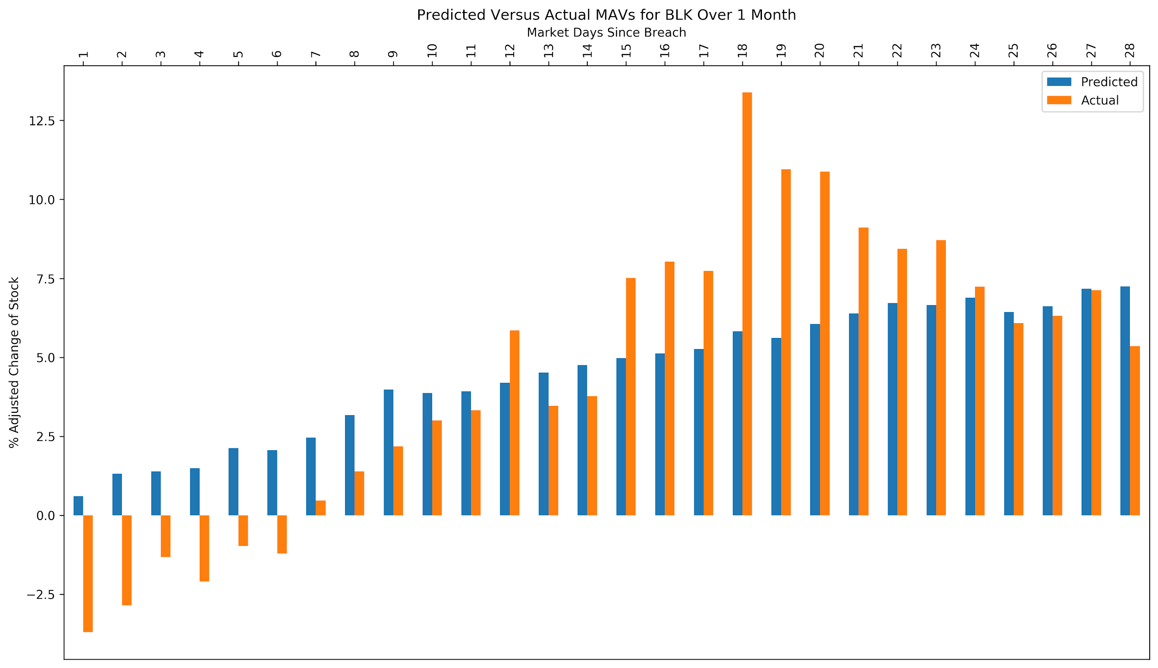
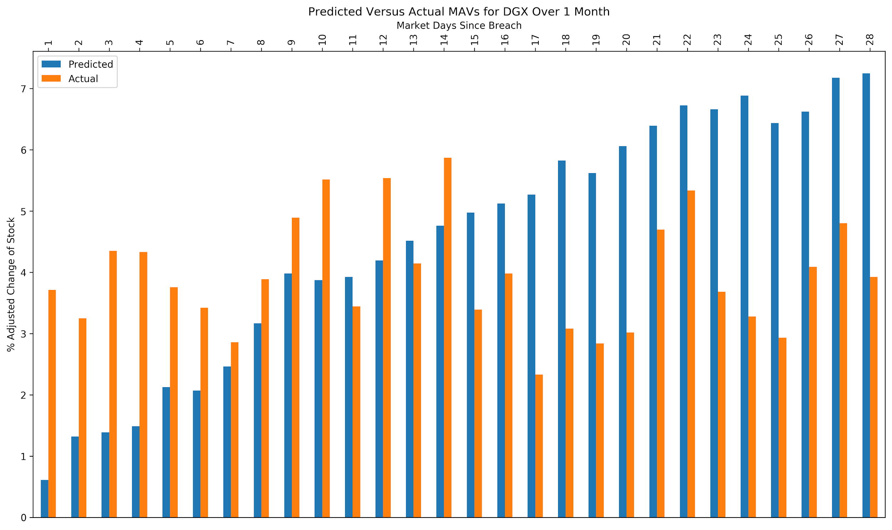
Non-Linear Predictions: Neural Nets
Multi-layer Perceptron regressor Using adam
R^2 approaching 62%

Slide 39
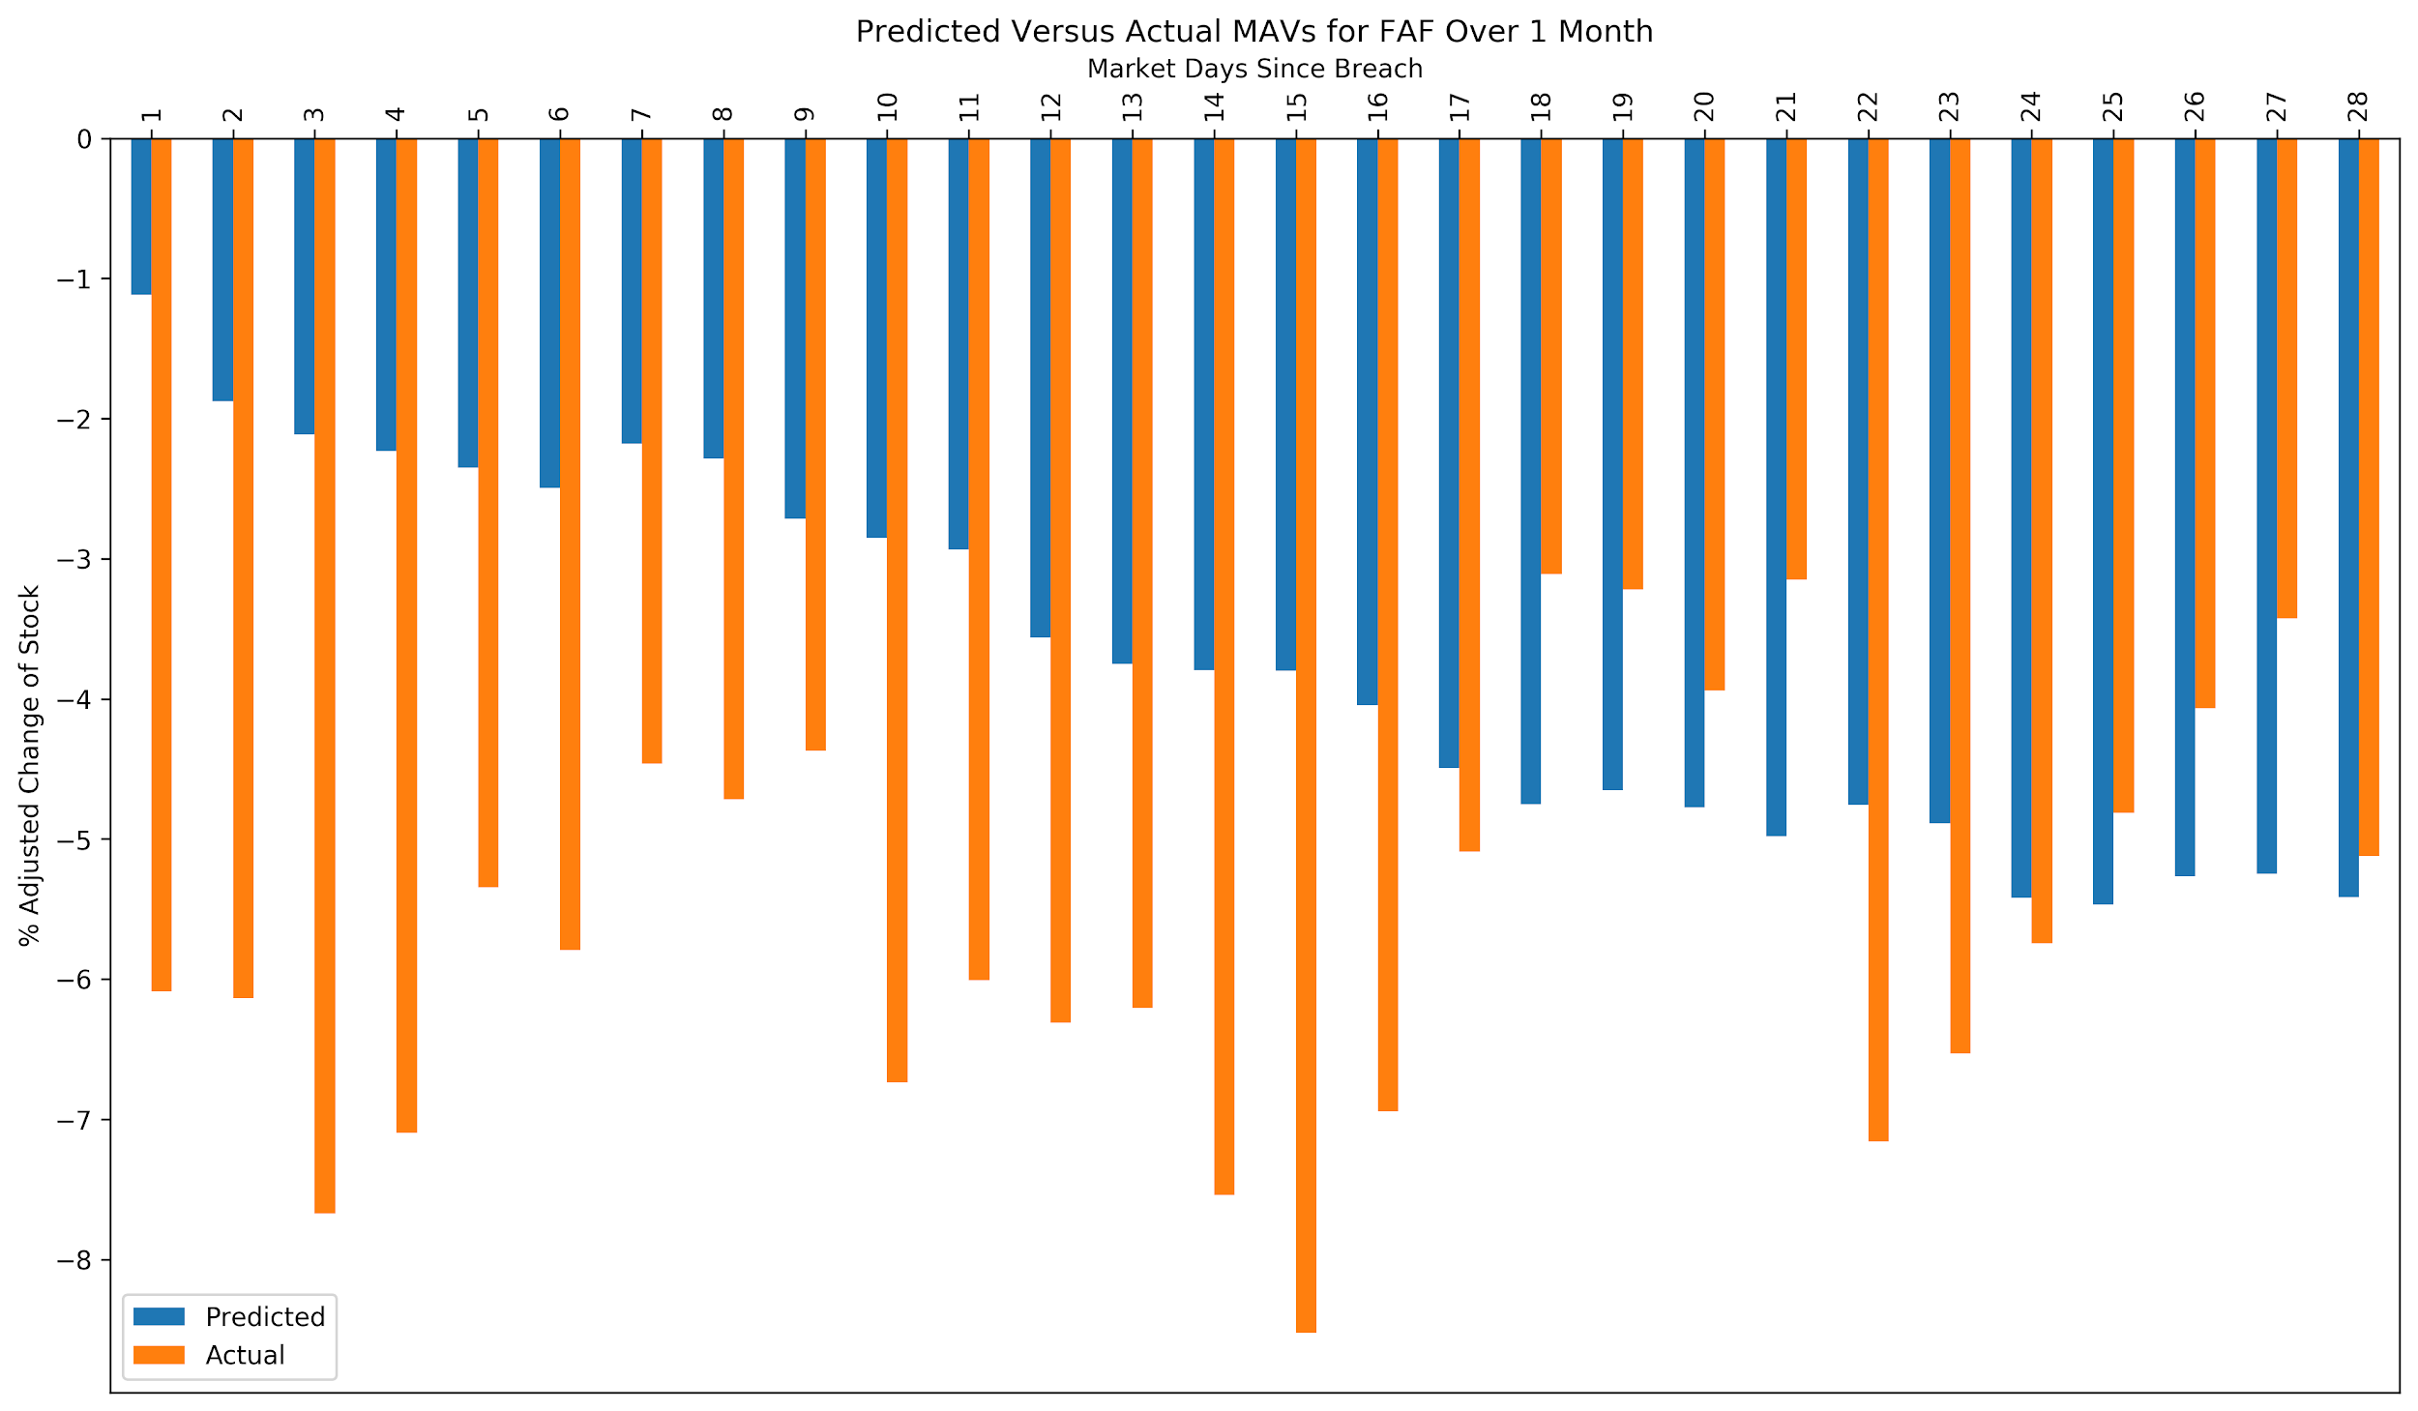
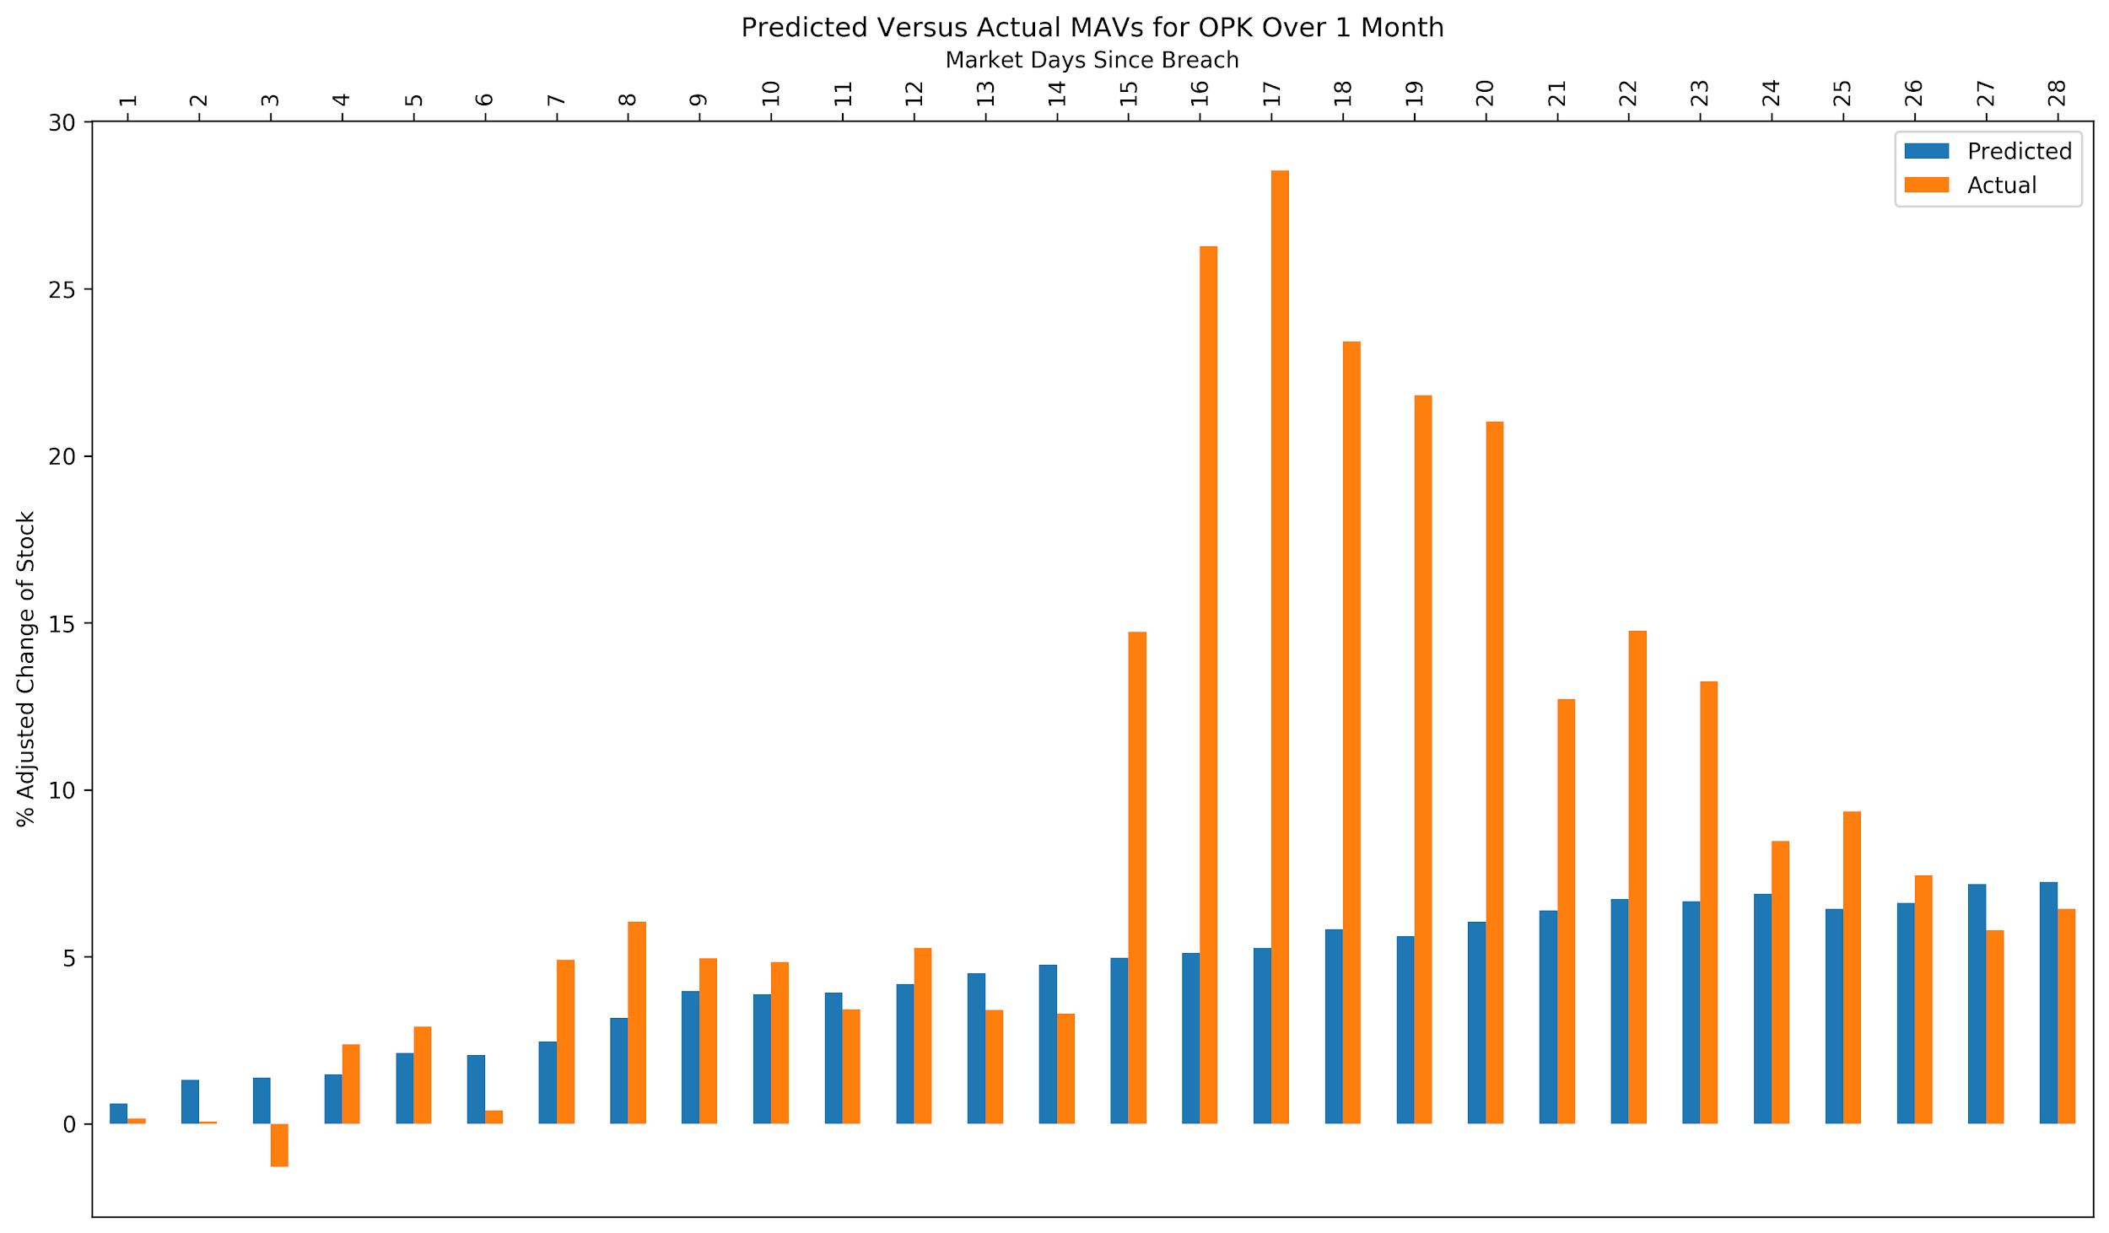

Non-Linear Predictions: Neural Nets
Multi-layer Perceptron regressor Using adam
R^2 approaching 62%

Slide 40
Interpreted Results
On average stocks will underperform the market following a breach*
There isn’t an identified way to play breaches 100% of the time
We need to better refine our features and gather more data
Country
Market/Type of Fund
Cyclic Factors
Age
Breached Aspects
*With statistical significance

Slide 41
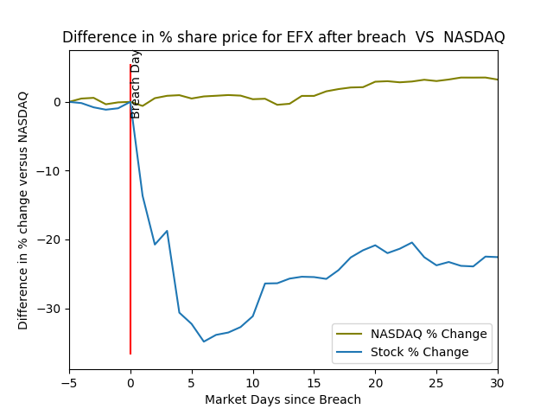
The Ugly: Equifax

Slide 42
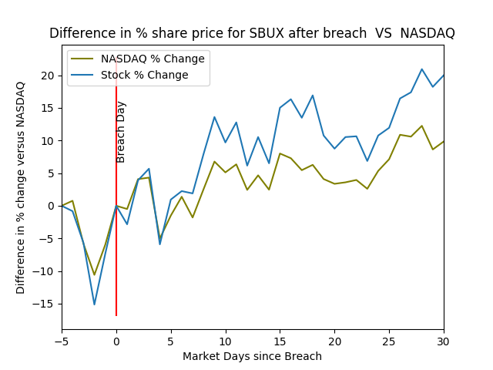
The Good: Starbucks

Slide 43

Choose your bets responsibly

Slide 44
Questions
You can find the data, Jupyter Notebooks, Images and more at:
https://github.com/csanders-git/StockData

